Slide 1
APPLIED COST-EFFECTIVENESS MODELING WITH R
ISPOR
August 11/12, 2021
Devin Incerti
Jeroen Jansen

Slide 2
Learning objectives
Understand how R can be used to perform model-based cost-effectiveness analysis with existing packages;
Develop own models in R by modifying existing code for commonly used model types;
Understand how using R can improve reproducibility and transparency of model-based cost-effectiveness analysis

Slide 3
Agenda
Day 1
Introduction
Basic model taxonomy
Simple Markov cohort model
Incorporating PSA
Cost-effectiveness analysis
Day 2
Simple Markov cohort model in hesim
Semi-Markov multi-state model
Partitioned survival model
Summary

Slide 4
Structure
Presentation
Exercises using R

Slide 5
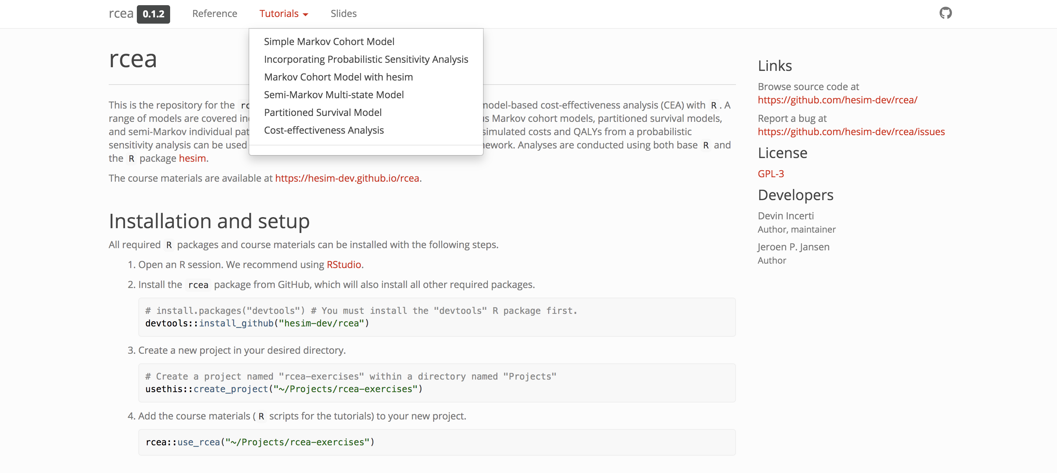
Online tutorial
https://hesim-dev.github.io/rcea/

Slide 6

R scrips for exercises

Slide 7
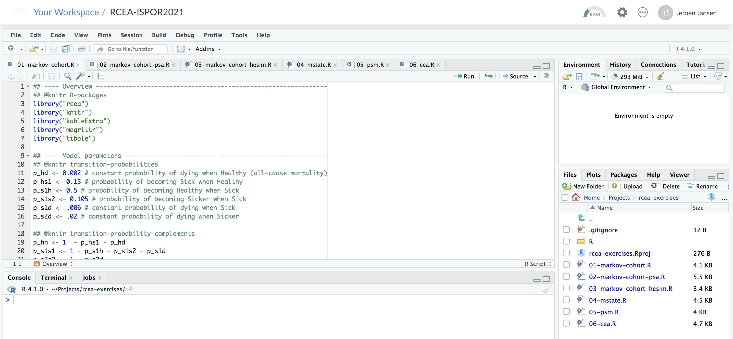
RStudio Cloud

Slide 8
Introduction

Slide 9
Criteria that economic models should strive to meet
Clinical realism
A model should reflect the state of evidence, the current understanding of the disease, and be accepted by clinical experts.
Quantifying decision uncertainty
A model should be capable of quantifying decision uncertainty and informing prioritization of future research.
Transparency and reproducibility
Resources should exist so that a model can be completely understood, reproduced, and pressure tested.
Reusability and adaptability
It should be possible to easily update a model to reflect new clinical evidence or adapt it for a new market, indication, or intervention.
Notes:
Historically, models have been developed with specialized commercial software (such as TreeAge) or more commonly with spreadsheet software (almost always Microsoft Excel). Although these tools may be sufficient for relatively simple analyses, methodological and computational advances now allow for models that are increasingly sophisticated and realistic but cannot be reasonably computed in Excel. Related fields such as statistics, economics, and machine learning utilize many of these advances and consequently make heavy use of modern programming languages such as R, Python, MATLAB, and Julia.¹⁻⁴ Yet, in the context of HTA, there seems to be an ongoing preference among manufactures preparing submissions and reviewers for economic models in Excel.

Slide 10
Structural uncertainty
Notes:
How can we capture multiple model structures with excel

Slide 11

Plugging in model input parameter estimates

Slide 12
What do we mean with model transparency?
Concept, math
Face validity
Implementation/programming
Open-source, open-access
Familiarity with software?

Slide 13
Modeling in Excel
Excel has been dominant software platform used by HE modelers, especially for HTA submissions
Reasons are not surprising
Practically everyone with a computer has access to Excel
Does not require that you learn a new programming language
Many consider its “transparency” to be an attribute
With models in Excel, you can follow calculations that are being performed in every single cell of every single worksheet

Slide 14
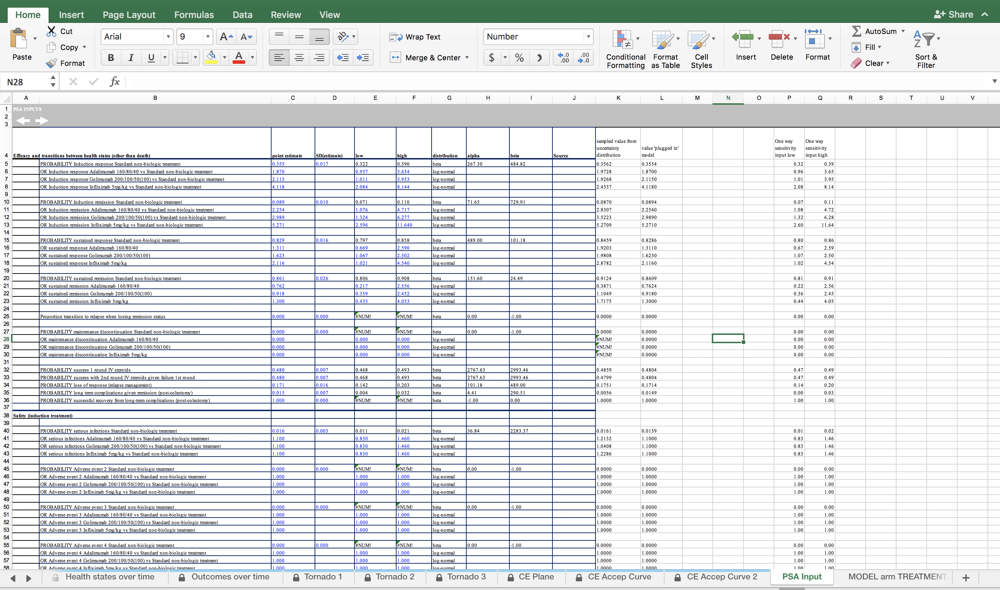

Slide 15


Slide 16
Where is Waldo

Slide 17

Time to change?

Slide 18
Alternative
BCEA heemod hesim …

Slide 19
What is R
Statistical programing language and environment for statistical computing
Free to use (open source, user developed packages that are transparent)
Very good for data management, statistical analysis, and visualization
Scripts contain all steps to perform an analysis
CEA models can be coded from ‘scratch’ using base R or via convenient and improving packages

Slide 20
Basic model taxonomy

Slide 21
Health states describing course of disease over time

Slide 22



Markov model
Clock forward
$$h_{}^{SD}\left(u\right)$$
$$h_{}^{SP}\left(u\right)$$
$$h_{}^{PD}\left(u\right)$$
transition rates depend only on time in model

Slide 23



Semi-Markov model
Clock reset
$$h_{}^{SD}\left(u\right)$$
$$h_{}^{SP}\left(u\right)$$
$$h_{}^{PD}\left(u,u_{P}\right)$$
transition rates depend on time in model
some transitions depend on time in an intermediate health state

Slide 24
Partitioned survival model
Source: Woods B, Sideris E, Palmer S, Latimer N, Soares M. NICE DSU Technical Support Document 19. Partitioned Survival Analysis for Decision Modelling in Health Care: A Critical Review. 2017 [Available from http://www.nicedsu.org.uk]

Slide 25
Summary of model types
 |  |  | discrete time | continuous time
State transition models | Markov (“Clock forward”) | Cohort | cohort discrete time state transition models (cDTSTM) time-homogeneous Markov models time-inhomogeneous Markov models | cohort continuous time state transition models
 |  | Individual-level | individual-level discrete time state transition models (iDTSTM) | individual-level continuous time state transition models (iCTSTM)
 | Semi-Markov (“Clock reset”)* | Individual-level | iDTSTM | iCTSTM
Partitioned survival model |  | Cohort |  | ✓
*tunnel states can be used in a cohort model to approximate a semi-Markov process

Slide 26
Simple Markov cohort model

Slide 27
Model

Slide 28
Model
 | Healthy | Sick | Sicker | Death
Healthy | 0.848 | 0.15 | 0 | 0.002
Sick | 0.5 | 0.389 | 0.105 | 0.006
Sicker | 0 | 0 | 0.98 | 0.02
Death | 0 | 0 | 0 | 1.000
Annual transition probabilities with SOC
Relative risk of progression to a worse health state with new intervention is 0.8
Drug costs
Other annual costs and utility
Annual discount rates of 3% for costs and 3% for QALYs
 | New | SOC
Drug costs | 12000 | 2000
 | Healthy | Sick | Sicker | Death
Direct medical | 2000 | 4000 | 15000 | 0
Utility | 1 | 0.75 | 0.5 | 0

Slide 29
SOC

Slide 30
Steps
Define transition matrix SOC
Define transition matrix New treatment
Define utility and cost values by health state
Calculate health state probabilities over time
Calculate expected QALYs and costs
Cost-effectiveness analysis

Slide 31
Define transition matrix with standard of care
p_hd <- 0.002 # constant probability of dying when Healthy (all-cause mortality)
p_hs1 <- 0.15 # probability of becoming Sick when Healthy
p_s1h <- 0.5 # probability of becoming Healthy when Sick
p_s1s2 <- 0.105 # probability of becoming Sicker when Sick
p_s1d <- 0.006 # constant probability of dying when Sick
p_s2d <- 0.02 # constant probability of dying when Sicker
p_hh <- 1 - p_hs1 - p_hd
p_s1s1 <- 1 - p_s1h - p_s1s2 – p_s1d
p_s2s2 <- 1 - p_s2d
p_soc <- matrix(
c(p_hh, p_hs1, 0, p_hd,
p_s1h, p_s1s1, p_s1s2, p_s1d,
0, 0, p_s2s2, p_s2d,
0, 0, 0, 1),
byrow = TRUE,
nrow = 4, ncol = 4
)
state_names <- c("H", "S1", "S2", "D")
colnames(p_soc) <- rownames(p_soc) <- state_names
print(p_soc)
H S1 S2 D
H 0.848 0.150 0.000 0.002
S1 0.500 0.389 0.105 0.006
S2 0.000 0.000 0.980 0.020
D 0.000 0.000 0.000 1.000

Slide 32
Relative risk and transition matrix with New treatment
apply_rr <- function(p, rr = .8){
p["H", "S1"] <- p["H", "S1"] * rr
p["H", "S2"] <- p["H", "S2"] * rr
p["H", "D"] <- p["H", ”D"] * rr
p["H", "H"] <- 1 - sum(p["H", -1])
p["S1", "S2"] <- p["S1", "S2"] * rr
p["S1", "D"] <- p["S1", "D"] * rr
p["S1", "S1"] <- 1 - sum(p["S1", -2])
p["S2", "D"] <- p["S2", "D"] * rr
p["S2", "S2"] <- 1 - sum(p["S2", -3])
return(p)
}
p_new <- apply_rr(p_soc, rr = .8)
p Transition probability matrix SOC
rr Relative risk with new treatment (default is 0.8)
H S1 S2 D
H 0.8784 0.1200 0.000 0.0016
S1 0.5000 0.4112 0.084 0.0048
S2 0.0000 0.0000 0.984 0.0160
D 0.0000 0.0000 0.000 1.0000

Slide 33
Utility and costs
utility <- c(1, .75, .5, 0)
costs_medical <- c(2000, 4000, 15000, 0)
costs_treat_soc <- c(rep(2000, 3), 0)
costs_treat_new <- c(rep(12000, 3), 0)
> utility
[1] 1.000 0.75 0.500 0.000
> costs_medical
[1] 2000 4000 15000 0
> costs_treat_soc
[1] 2000 2000 2000 0
> costs_treat_new
[1] 12000 12000 12000 0

Slide 34
Simulation – health state probabilities
Matrix multiplication
x_init <- c(1, 0, 0, 0)
x_init %*% p_soc
H S1 S2 D
[1,] 0.848 0.15 0 0.002
x_init %*% p_soc %*% p_soc
H S1 S2 D
[1,] 0.794104 0.18555 0.01575 0.004596

Slide 35
Simulation – health state probabilities with a function
x0 The state vector at model cycle 0 (i.e., the initial state vector)
p The transition probability matrix
n_cycles The number of model cycles. (Default is 85)
sim_markov_chain <- function(x0, p, n_cycles = 85){
x <- matrix(NA, ncol = length(x0), nrow = n_cycles) # Initialize Markov trace
x <- rbind(x0, x) # Markov trace at cycle 0 is initial state vector
colnames(x) <- colnames(p) # Columns are the health states
rownames(x) <- 0:n_cycles # Rows are the model cycles
for (t in 1:n_cycles){ # Simulating state vectors at each cycle with for loop
x[t + 1, ] <- x[t, ] %*% p
}
return(x)
}

Slide 36
Simulation – health state probabilities with a function
x_soc <- sim_markov_chain(x_init, p_soc)
x_new <- sim_markov_chain(x_init, p_new)
H S1 S2 D
0 1.0000000 0.00000000 0.00000000 0.000000000
1 0.8480000 0.15000000 0.00000000 0.002000000
2 0.7941040 0.18555000 0.01575000 0.004596000
3 0.7661752 0.19129455 0.03491775 0.007612508
4 0.7453638 0.18933986 0.05430532 0.010990981
5 0.7267385 0.18545778 0.07309990 0.014703854
6 0.7090031 0.18115385 0.09111097 0.018732076
7 0.6918116 0.17681931 0.10830990 0.023059224
8 0.6750659 0.17255445 0.12470973 0.027669961
9 0.6587331 0.16838356 0.14033376 0.032549614
---
79 0.1186504 0.03032935 0.29995426 0.551065992
80 0.1157802 0.02959568 0.29713976 0.557484354
81 0.1129795 0.02887975 0.29430451 0.563836283
82 0.1102465 0.02818114 0.29145079 0.570121611
83 0.1075796 0.02749943 0.28858079 0.576340207
84 0.1049772 0.02683421 0.28569662 0.582491978
85 0.1024378 0.02618509 0.28280028 0.588576870
H S1 S2 D
0 1.0000000 0.00000000 0.00000000 0.000000000
1 0.8784000 0.12000000 0.00000000 0.001600000
2 0.8315866 0.15475200 0.01008000 0.003581440
3 0.8078416 0.16342441 0.02291789 0.005816068
4 0.7913203 0.16414111 0.03627885 0.008259738
5 0.7771663 0.16245326 0.04948624 0.010894190
6 0.7638895 0.16006074 0.06234054 0.013709211
7 0.7510309 0.15748372 0.07478819 0.016697175
8 0.7384474 0.15488101 0.08682021 0.019851357
9 0.7260927 0.15230076 0.09844109 0.023165425
---
79 0.2230518 0.04678750 0.31880122 0.411359506
80 0.2193224 0.04600523 0.31763055 0.417041788
81 0.2156554 0.04523604 0.31641290 0.422695618
82 0.2120498 0.04447971 0.31515012 0.428320406
83 0.2085044 0.04373603 0.31384402 0.433915590
84 0.2050182 0.04300478 0.31249634 0.439480634
85 0.2015904 0.04228575 0.31110880 0.445015028

Slide 37
Computing a present value with a function
pv <- function(z, dr, t) {
z/(1 + dr)^t
}
z A numeric quantity
dr Discount rate
t Vector of times to compute the present value
pv(1000, dr = .03, t = 0:4)
[1] 1000.0000 970.8738 942.5959 915.1417 888.4870

Slide 38
QALYs after 1st cycle
x_soc[2, ] # State occupancy probabilities after 1st cycle
H S1 S2 D
0.848 0.150 0.000 0.002
sum(x_soc[2, 1:3]) # Expected life-years after 1st cycle
[1] 0.998
sum(x_soc[2, ] * utility) # Expected utility after 1st cycle
[1] 0.9605
sum(pv(x_soc[2, ] * utility, .03, 1)) # Expected discounted utility after 1st cycle
[1] 0.9325

Slide 39
Discounted QALYs for each cycle
compute_qalys <- function(x, utility, dr = .03){
n_cycles <- nrow(x) - 1
pv(x %*% utility, dr, 0:n_cycles)
}
dqalys_soc <- compute_qalys(x_soc, utility = utility)
dqalys_new <- compute_qalys(x_new, utility = utility)
head(dqalys_soc)
head(dqalys_new)
[,1]
0 1.0000000
1 0.9325243
2 0.8871161
3 0.8484324
4 0.8125404
5 0.7784024
[,1]
0 1.0000000
1 0.9401942
2 0.8980022
3 0.8619435
4 0.8285724
5 0.7968343

Slide 40
Discounted cost for each cycle
compute_costs <- function(x, costs_medical, costs_treat, dr = .03){
n_cycles <- nrow(x) - 1
costs <- cbind(pv(x %*% costs_medical, dr, 0:n_cycles),
pv(x %*% costs_treat, dr, 0:n_cycles)
)
colnames(costs) <- c("medical", "treatment")
return(costs)
}
dcosts_soc <- compute_costs(x_soc, costs_medical, costs_treat_soc)
dcosts_new <- compute_costs(x_new, costs_medical, costs_treat_new)
head(dcosts_soc)
head(dcosts_new)
medical treatment
0 2000.000 2000.000
1 2229.126 1937.864
2 2419.321 1876.527
3 2581.884 1816.350
4 2721.140 1757.443
5 2839.541 1699.850
medical treatment
0 2000.000 12000.00
1 2171.650 11631.84
2 2293.695 11270.64
3 2391.402 10917.83
4 2473.004 10573.78
5 2541.624 10238.54

Slide 41
Cost-effectiveness
(sum(dcosts_new[-1, ]) - sum(dcosts_soc[-1, ])) /
(sum(dqalys_new[-1, ]) - sum(dqalys_soc[-1, ]))
[1] 122946.8
format_costs <- function(x) formatC(x, format = "d", big.mark = ",")
format_qalys <- function(x) formatC(x, format = "f", digits = 2)
make_icer_tbl <- function(costs0, costs1, qalys0, qalys1){
# Computations
total_costs0 <- sum(costs0)
total_costs1 <- sum(costs1)
total_qalys0 <- sum(qalys0)
total_qalys1 <- sum(qalys1)
incr_total_costs <- total_costs1 - total_costs0
inc_total_qalys <- total_qalys1 - total_qalys0
icer <- incr_total_costs/inc_total_qalys
# Make table
tibble(
`Costs` = c(total_costs0, total_costs1) %>%
`Strategy` = c("SOC", "New"),
format_costs(),
`QALYs` = c(total_qalys0, total_qalys1) %>%
format_qalys(),
`Incremental costs` = c("--", incr_total_costs %>% format_costs()),
`Incremental QALYs` = c("--", inc_total_qalys %>% format_qalys()),
`ICER` = c("--", icer %>% format_costs())
) %>%
kable() %>%
kable_styling() %>%
footnote(general = "Costs and QALYs are discounted at 3% per annum.", footnote_as_chunk = TRUE)
}

Slide 42
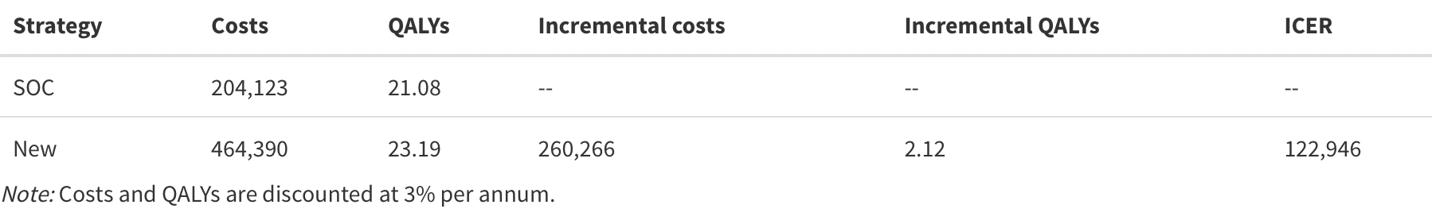
Cost-effectiveness
make_icer_tbl(costs0 = dcosts_soc[-1, ], costs1 = dcosts_new[-1, ],
qalys0 = dqalys_soc[-1, ], qalys1 = dqalys_new[-1, ])

Slide 43
Steps
Define transition matrix SOC
Define transition matrix New treatment apply_rr(p_soc, rr)
Define utility and cost values by health state
Calculate health state probabilities over time sim_markov_chain(x0, p, n_cycles)
Calculate expected QALYs and costs
pv(z, dr, t)
compute_qalys(x, utility, dr)
compute_costs(x, costs_medical, costs_treat, dr)
Cost-effectiveness analysis make_icer_tbl(costs0, costs1, qalys0, qalys1)

Slide 44
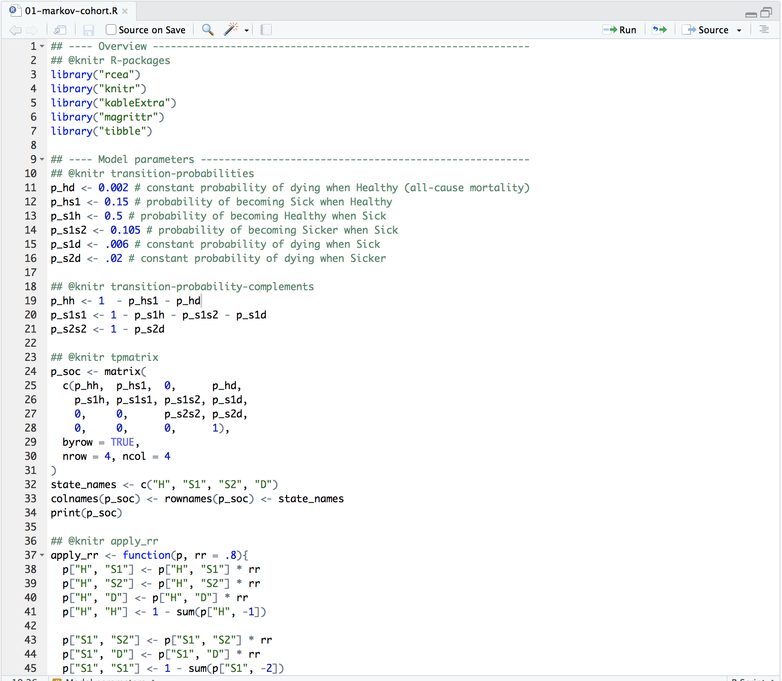
Complete R script

Slide 45
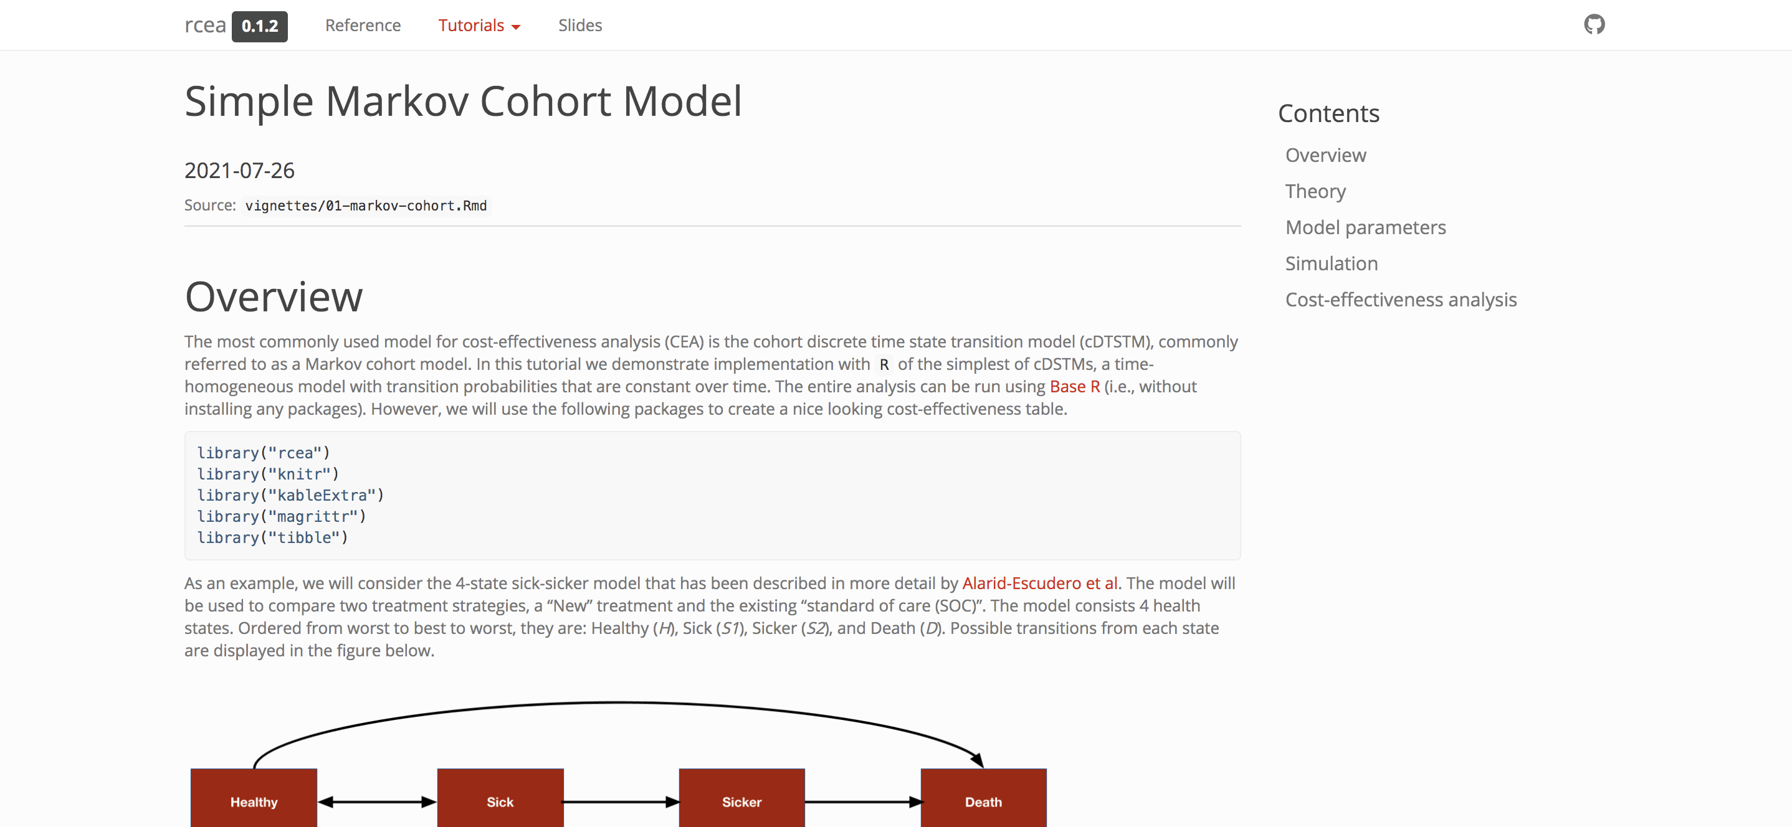
Tutorial
https://hesim-dev.github.io/rcea/articles/01-markov-cohort.html

Slide 46
Exercise 1: Simple Markov Cohort model
Modify R-script “01-markov-cohort-R”
Change relative risk
Change drug costs
Change utilities
Change follow-up time (i.e. number of cycles)
sim_markov_chain(x0, p, n_cycles)
Run modified script

Slide 47
Simple Markov cohort model – Incorporating probabilistic sensitivity analysis

Slide 48
Probabilistic sensitivity analysis
The standard methodology for quantifying the impact of parameter uncertainty is probabilistic sensitivity analysis (PSA)
Propagating uncertainty in the input parameters throughout the model by randomly sampling sets of input values from suitable probability distributions
Probability distributions are determined according to the distributional properties of the statistical estimates, which, in turn, depend on the statistical techniques used and the distributions of the underlying data
R is a natural programming language for performing PSA
Random samples can be drawn from almost any probability distribution

Slide 49
Transition probabilities for SOC
We assume that summary level data is available on transitions from the Healthy state (n = 1000), Sick state (n = 1000), and Sicker state (n = 800).
The transitions from each state to the other 4 states can be modeled using a Dirichlet distribution
transitions_soc <- matrix(
c(848, 150, 0, 2,
500, 389, 105, 6,
0, 0, 784, 16,
0, 0, 0, 23),
nrow = 4, byrow = TRUE)
state_names <- c("H", "S1", "S2", "D")
colnames(transitions_soc) <- rownames(transitions_soc) <- tolower(state_names)
h s1 s2 d
h 848 150 0 2
s1 500 389 105 6
s2 0 0 784 16
d 0 0 0 23

Slide 50
Combining all model parameters
params <- list(
alpha_soc = transitions_soc,
lrr_mean = log(.8),
lrr_lower = log(.71),
lrr_upper = log(.9),
c_medical = c(H = 2000, S1 = 4000, S2 = 15000, D = 0),
c_soc = 2000,
c_new = 12000,
u_mean = c(H = 1, S1 = .75, S2 = 0.5, D = 0),
u_se = c(H = 0, S1 = 0.03, S2 = 0.05, D = 0.0)
)

Slide 51
Simulation
The simulation proceeds by
randomly sampling the parameters from the probability distributions specified
running the Markov model for each draw of the parameters
The result is a draw from the probability distribution of each of the model outputs of interest (i.e., state probabilities, QALYs, and costs).

Slide 52
Sampling parameters
While Base R can be used to draw samples of parameters, the functions hesim::define_rng() and hesim::eval_rng() simplify this process.
Any random number generation function can be used inside the define_rng() block
rng_def <- define_rng({
lrr_se <- (lrr_upper - lrr_lower)/(2 * qnorm(.975))
list( # Parameters to return
p_soc = dirichlet_rng(alpha_soc),
rr_new = lognormal_rng(lrr_mean, lrr_se),
c_medical = gamma_rng(mean = c_medical, sd = c_medical),
c_soc = c_soc,
c_new = c_new,
u = beta_rng(mean = u_mean, sd = u_se)
)
}, n = 1000)
params_rng <- eval_rng(rng_def, params = params)

Slide 53
Sampling parameters
names(params_rng)
[1] "p_soc" "rr_new" "c_medical" "c_soc" "c_new" "u"
head(as.matrix(params_rng$p_soc))
h_h h_s1 h_s2 h_d s1_h s1_s1 s1_s2 s1_d s2_h s2_s1
[1,] 0.8686001 0.1293872 0 0.002012649 0.5003043 0.3847703 0.10868135 0.006244105 0 0
[2,] 0.8474698 0.1499868 0 0.002543368 0.5146218 0.3964675 0.08375492 0.005155768 0 0
[3,] 0.8559237 0.1428611 0 0.001215126 0.5117574 0.3775261 0.10868021 0.002036291 0 0
[4,] 0.8550586 0.1429657 0 0.001975648 0.5139857 0.3777508 0.10303967 0.005223752 0 0
[5,] 0.8678962 0.1304462 0 0.001657694 0.5164343 0.3815376 0.09725638 0.004771722 0 0
[6,] 0.8530231 0.1459388 0 0.001038023 0.4991514 0.3750200 0.11846736 0.007361245 0 0
s2_s2 s2_d d_h d_s1 d_s2 d_d
[1,] 0.9786377 0.02136235 0 0 0 1
[2,] 0.9871702 0.01282980 0 0 0 1
[3,] 0.9786291 0.02137091 0 0 0 1
[4,] 0.9809938 0.01900624 0 0 0 1
[5,] 0.9793886 0.02061141 0 0 0 1
[6,] 0.9750211 0.02497889 0 0 0 1

Slide 54
Simulating the Markov model
One way that a Markov simulation can be generalized is to store “input data” in an object, i.e. data frame.
Input data might consist of
treatment strategies
patients and subgroups
For instance, if we were simulating different subgroups we might store the age and sex associated with the subgroup which could, in turn, be used as covariates in a statistical model.
data <- data.frame(
strategy = c("New", "SOC")
)
strategy
1 New
2 SOC

Slide 55
Simulating the Markov model – Create the function
Set up a sim_model() function that runs the entire simulation.
Comprised of three smaller functions:
sim_stateprobs()
compute_qalys()
compute_costs()

Slide 56
Simulating the Markov model – Create the function
sim_stateprobs <- function(p0, rr, strategy, n_cycles){
rr <- ifelse(strategy == "New", rr, 1)
p <- tpmatrix(
C, p0$h_s1 * rr, p0$h_s2 * rr, p0$h_d * rr,
p0$s1_h, C, p0$s1_s2 * rr, p0$s1_d * rr,
p0$s2_h, p0$s2_s1, C, p0$s2_d * rr,
0, 0, 0, 1
)
x <- sim_markov_chain(x0 = c(1, 0, 0, 0),
p = matrix(as.matrix(p), ncol = 4, byrow = TRUE),
n_cycles = n_cycles)
return(x)
}
hesim::tpmatrix() makes it easy to define a transition probability matrix.
C denotes that a given element is the complement of all other elements in that row, ensuring that the probabilities sum to 1.
sim_markov_chain() is the function we created previously

Slide 57
Simulating the Markov model – Create the function
# QALYs
compute_qalys <- function(x, utility, dr = .03){
n_cycles <- nrow(x) - 1
pv(x %*% utility, dr, 0:n_cycles)
}
# Costs
compute_costs <- function(x, costs_medical, costs_treat, dr = .03){
n_cycles <- nrow(x) - 1
costs_treat <- c(rep(costs_treat, 3), 0)
costs <- cbind(
pv(x %*% costs_medical, dr, 0:n_cycles),
pv(x %*% costs_treat, dr, 0:n_cycles)
)
colnames(costs) <- c("dcost_med", "dcost_treat")
return(costs)
}

Slide 58
Simulating the Markov model
sim_model <- function(params_rng, data, n_cycles = 85, dr_qalys = .03, dr_costs = .03){
# Initialize array of matrices
n_samples <- attr(params_rng, "n")
n_strategies <- nrow(data)
out <- array(NA, dim = c(n_cycles + 1, 7, n_samples * n_strategies))
dimnames(out) <- list(NULL, c("H", "S1", "S2", "D", "dqalys", "dcosts_med", "dcosts_treat"), NULL)
# Run the simulation
i <- 1
for (s in 1:n_samples){ # Start PSA loop
for (k in 1:n_strategies) { # Start treatment strategy loop
x <- sim_stateprobs(p0 = params_rng$p_soc[s, ],
rr = params_rng$rr_new[s],
strategy = data$strategy[k],
n_cycles = n_cycles)
dqalys <- compute_qalys(x, utility = unlist(params_rng$u[s]),dr = dr_qalys)
dcosts <- compute_costs(x,
costs_medical = unlist(params_rng$c_medical[s]),
costs_treat = ifelse(data$strategy[k] == "SOC",
params_rng$c_soc,
params_rng$c_new), dr = dr_costs)
out[, , i] <- cbind(x, dqalys, dcosts)
i <- i + 1
} # End treatment strategy loop
} # End PSA loop
# Store metadata and return
attr(out, "n_samples") <- n_samples
attr(out, "strategies") <- data$strategy
return(out)
}
PSA. samples; tx strategy; no. cycles; discount rates
An array to store the output.
A series of matrices each with n_cycles rows and columns for each output.
There is one matrix for each parameter sample for the PSA and treatment strategy.
Simulates for each parameter sample and treatment strategy
state probabilities (with sim_stateprobs())
QALYs (with compute_qalys())
costs (with compute_costs())
The number of parameter samples and the names of the treatment strategies are saved as attributes (i.e., metadata) to the array.

Slide 59
Simulating the Markov model
sim_out <- sim_model(params_rng, data = data)
head(sim_out[, , 1])
H S1 S2 D dqalys dcosts_med dcosts_treat
[1,] 1.0000000 0.0000000 0.000000000 0.000000000 1.0000000 639.2051 12000.00
[2,] 0.8927749 0.1055827 0.000000000 0.001642364 0.9440327 968.8714 11631.35
[3,] 0.8498706 0.1371191 0.009363733 0.003646603 0.9027066 1072.4091 11269.90
[4,] 0.8273444 0.1453902 0.021361082 0.005904295 0.8667374 1105.0422 10916.86
[5,] 0.8113717 0.1463692 0.033882825 0.008376274 0.8332591 1114.3372 10572.54
[6,] 0.7976015 0.1450801 0.046273111 0.011045289 0.8013670 1114.9710 10236.97

Slide 60
Reorganize output
sim_out <- array_to_dt(sim_out)
head(sim_out)
Convert a 3D array (faster to store data) to a data.table so we can summarize outcomes for each parameter sample and treatment strategy very quickly.
cycle strategy sample H S1 S2 D dqalys dcosts_med dcosts_treat
1: 0 New 1 1.0000000 0.0000000 0.000000000 0.000000000 1.0000000 639.2051 12000.00
2: 1 New 1 0.8927749 0.1055827 0.000000000 0.001642364 0.9440327 968.8714 11631.35
3: 2 New 1 0.8498706 0.1371191 0.009363733 0.003646603 0.9027066 1072.4091 11269.90
4: 3 New 1 0.8273444 0.1453902 0.021361082 0.005904295 0.8667374 1105.0422 10916.86
5: 4 New 1 0.8113717 0.1463692 0.033882825 0.008376274 0.8332591 1114.3372 10572.54
6: 5 New 1 0.7976015 0.1450801 0.046273111 0.011045289 0.8013670 1114.9710 10236.97

Slide 61
Cost-effectiveness output
ce_sim <- sim_out[cycle != 0,
.(dqalys = sum(dqalys),
dcosts = sum(dcosts_med) + sum(dcosts_treat)),
by = c("sample", "strategy")]
ce_sim
sample strategy dqalys dcosts
1: 1 New 23.30567 372636.3
2: 1 SOC 21.36614 103030.7
3: 2 New 23.49382 380159.8
4: 2 SOC 22.71959 104017.1
5: 3 New 23.35243 463270.5
---
1996: 998 SOC 20.63295 166641.1
1997: 999 New 21.82111 356686.6
1998: 999 SOC 19.58578 104643.0
1999: 1000 New 23.03594 559476.0
2000: 1000 SOC 21.79923 320811.6
Save for later
saveRDS(ce_sim, file = "markov-cohort-ce_sim.rds")

Slide 62
Cost-effectiveness output
ce_sim_wider <- dcast(ce_out, sample ~ strategy,
value.var = c("dqalys", "dcosts"))
ce_sim_wider
sample dqalys_New dqalys_SOC dcosts_New dcosts_SOC
1: 1 23.30567 21.36614 372636.3 103030.72
2: 2 23.49382 22.71959 380159.8 104017.07
3: 3 23.35243 21.81066 463270.5 207518.50
4: 4 23.49622 21.45324 680491.2 474308.21
5: 5 24.11580 22.73777 492869.3 239480.34
---
996: 996 23.05054 20.86090 578855.4 336586.31
997: 997 24.22340 22.48457 379255.5 93578.69
998: 998 22.22956 20.63295 452278.4 166641.12
999: 999 21.82111 19.58578 356686.6 104642.99
1000: 1000 23.03594 21.79923 559476.0 320811.62

Slide 63
Cost-effectiveness output
ce_sim_wider[, idcosts := dcosts_New - dcosts_SOC]
ce_sim_wider[, idqalys := dqalys_New - dqalys_SOC]
sample dqalys_New dqalys_SOC dcosts_New dcosts_SOC idcosts idqalys
1: 1 23.30567 21.36614 372636.3 103030.72 269605.6 1.9395308
2: 2 23.49382 22.71959 380159.8 104017.07 276142.7 0.7742344
3: 3 23.35243 21.81066 463270.5 207518.50 255752.0 1.5417635
4: 4 23.49622 21.45324 680491.2 474308.21 206183.0 2.0429732
5: 5 24.11580 22.73777 492869.3 239480.34 253388.9 1.3780308
---
996: 996 23.05054 20.86090 578855.4 336586.31 242269.1 2.1896429
997: 997 24.22340 22.48457 379255.5 93578.69 285676.8 1.7388263
998: 998 22.22956 20.63295 452278.4 166641.12 285637.3 1.5966079
999: 999 21.82111 19.58578 356686.6 104642.99 252043.6 2.2353267
1000: 1000 23.03594 21.79923 559476.0 320811.62 238664.4 1.2367111
ce_sim_wider[, .(icer = mean(idcosts)/mean(idqalys))]
icer
1: 125028.7

Slide 64
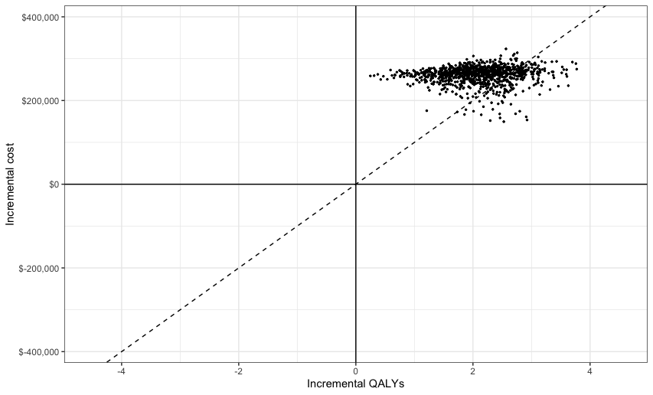
Cost-effectiveness plane

Slide 65
Steps
Define uncertainty for all model input parameters
Sampling parameter values hesim::define_rng(), hesim::eval_rng()
Define treatment strategies and population (data)
Simulating the Markov model
sim_model(params_rng, data, n_cycles, dr_qalys, dr_costs)
sim_stateprobs(po, rr, strategy, n_cycles)
compute_qalys(x, utility, dr)
compute_costs(x, cost_medical, costs_treat, dr)
Reorganize output rbind_array(), array_to_dt()
Cost-effectiveness analysis

Slide 66
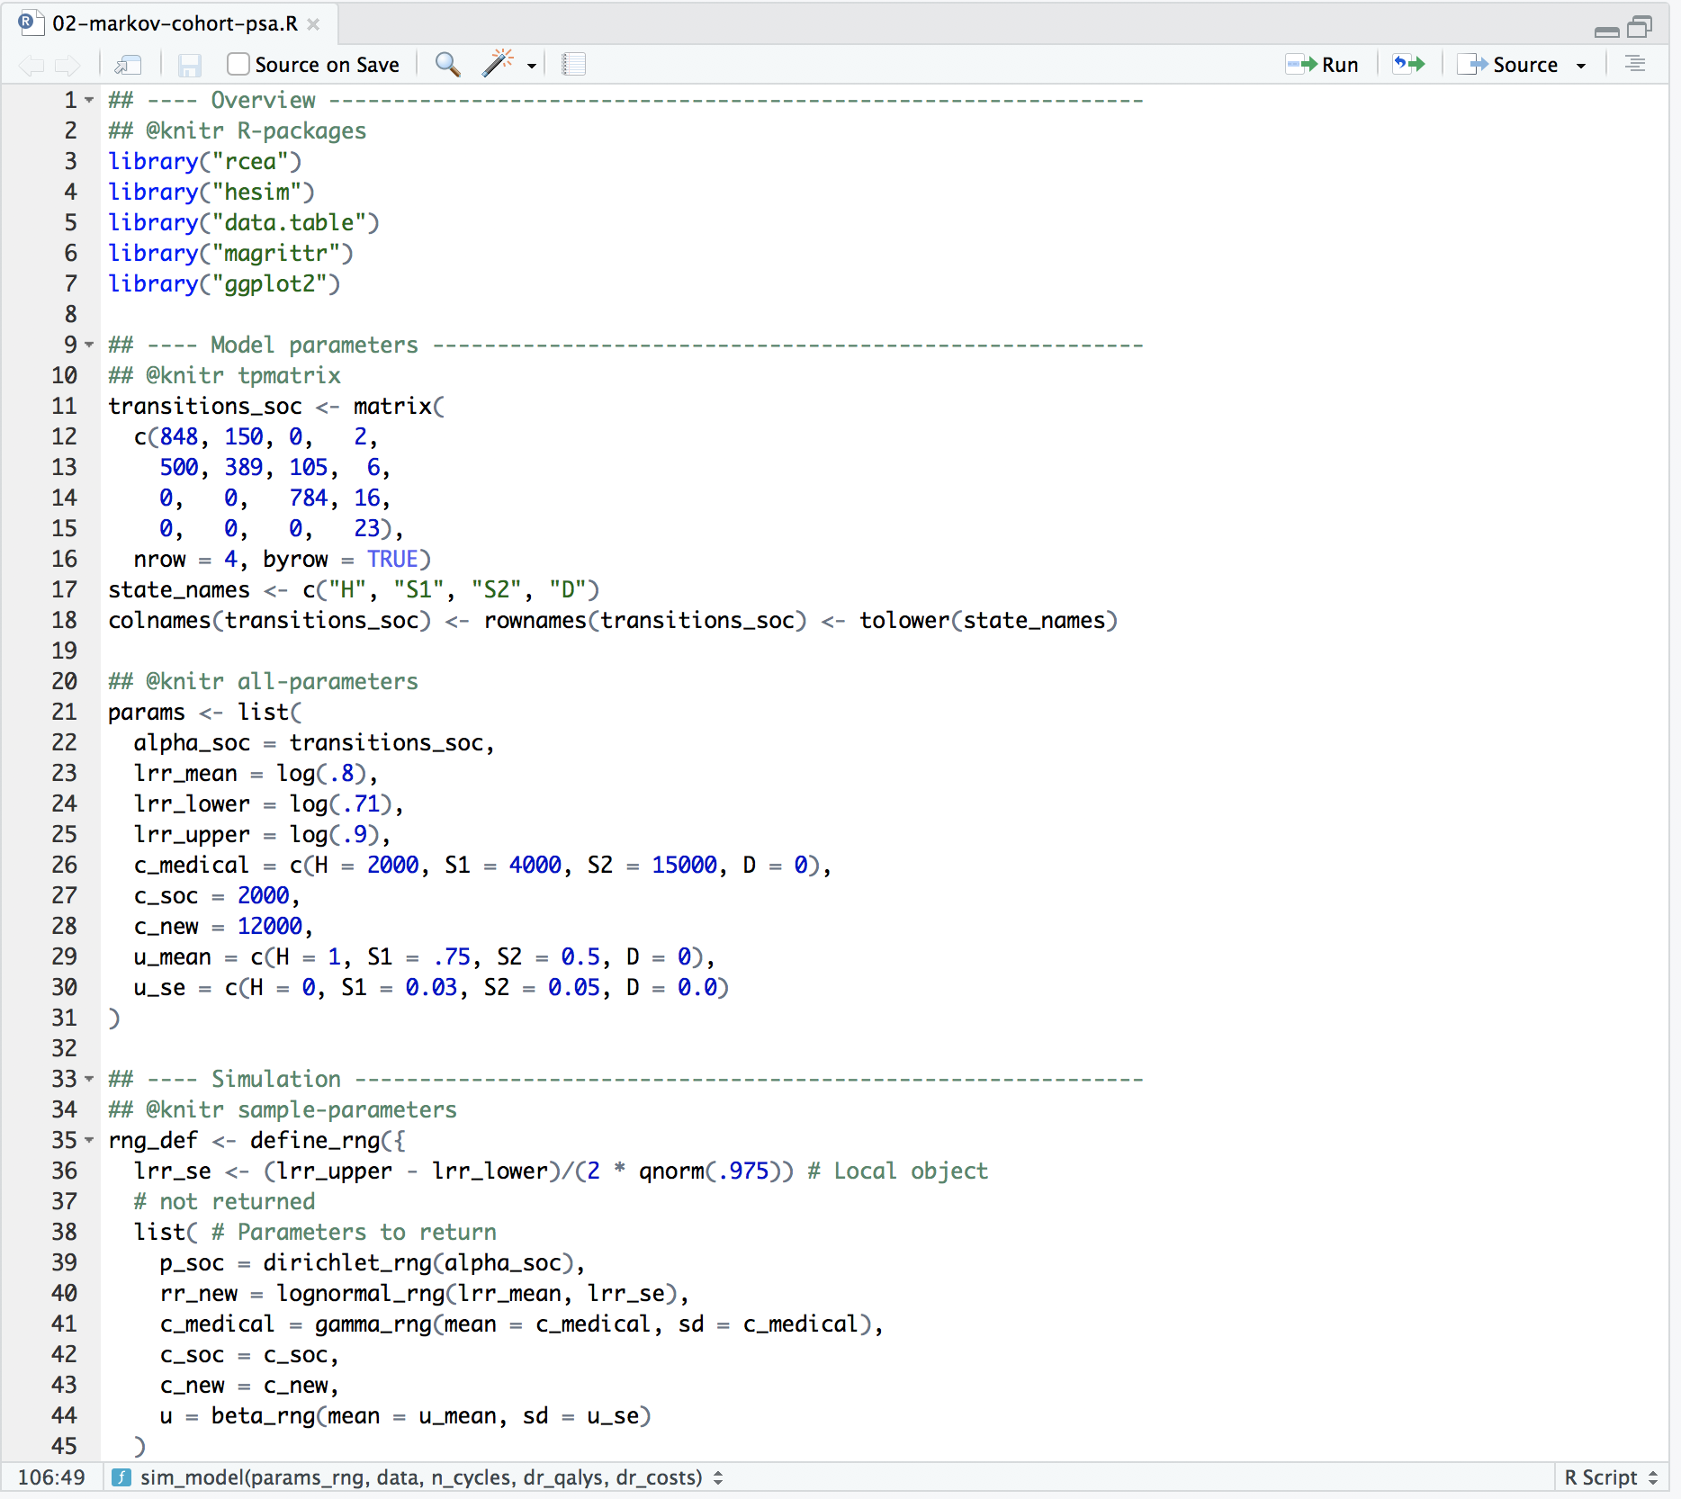
Complete R script

Slide 67
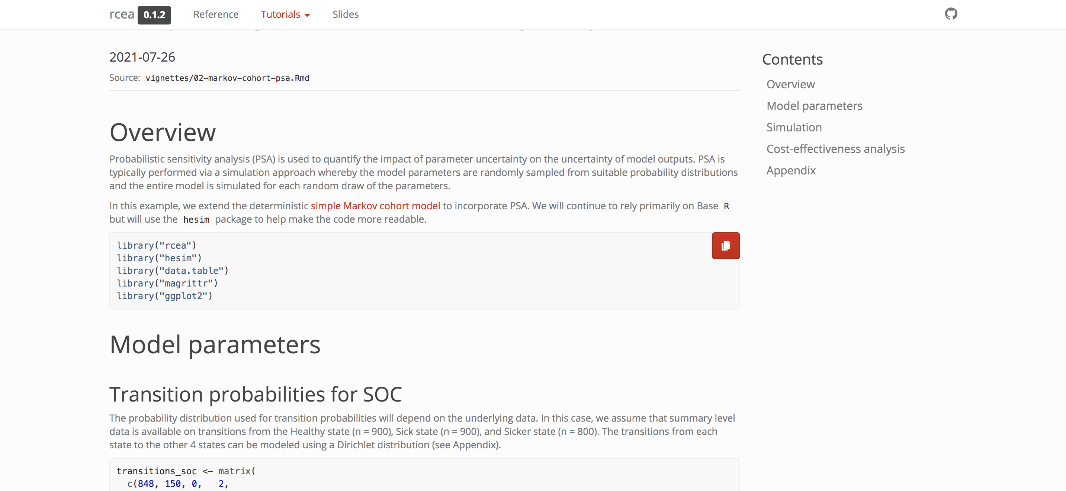
Tutorial
https://hesim-dev.github.io/rcea/articles/02-markov-cohort-psa.html
Notes:
Present code with pkgdown documentation

Slide 68
Exercise 2: Incorporating probabilistic sensitivity analysis
Modify R-script “02-markov-cohort-psa.R”
Reduce sample size of data for transition matrix by 50%
Increase confidence interval for relative risk
Run modified script

Slide 69
Cost-effectiveness analysis

Slide 70


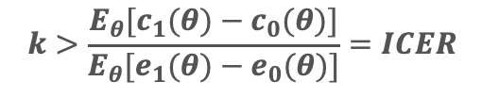


Cost-effectiveness analysis
The optimal treatment strategy is the one that maximizes the expected net monetary benefit (NMB)
$$NMB\left(j,θ\right)=e_{j}\left(θ\right)⋅k−c_{j}\left(θ\right)$$
j indexes a treatment strategy
$θ$ indexes a parameter set
Effectiveness (e.g., QALYs)
Willingness to pay
Costs
$$j^{∗}=argmax_{j}E_{θ}[NMB\left(j,θ\right)]$$
j* is treatment with highest NMB averaged across all sets of $θ$
Can also assess optimal strategy using incremental cost-effectiveness ratio (ICER). Treatment 1 is preferred to treatment 0 if¹
$$k>\frac{E_{θ}[c_{1}(θ)−c_{0}(θ)]}{E_{θ}[e_{1}(θ)−e_{0}(θ)]}=ICER$$
¹Only true if both incremental costs (numerator) and incremental effectiveness (denominator) are both positive. Treatment 1 dominates treatment 0 if it is more effective and less costly. Treatment 1 is dominated by treatment 0 if it is less effective and more costly. Treatment 1 is preferred to treatment 0 if it is less costly and less effective when k < ICER.

Slide 71
Value of perfect information
The expected value of perfect information (EVPI) combines the probability of being most effective with the magnitude of the expected NMB
Intuitively, EVPI is the amount that a decision maker would be willing to pay to collect additional data and completely eliminate uncertainty
Mathematically, the EVPI is defined as the difference between the maximum expected NMB given perfect information and the maximum expected NMB given current information
$$EVPI=E_{θ}[\max_{j}{NMB\left(j,θ\right)]−\max_{j}E_{θ}[NMB\left(j,θ\right)]}$$
NMB for optimal treatment at each random draw of the parameters
NMB of treatment that is optimal when averaged across all parameter draws

Slide 72
Cost-effectiveness analysis with hesim
hesim can be used to perform CEA and summarize decision uncertainty (other R packages such as BCEA could also be considered)
Implementation via the cea()and cea_pw() functions
cea() summarizes results by taking into account each treatment strategy in the analysis
cea_pw() summarizes “pairwise” results in which each treatment is compared to a comparator
Both are ”generic” functions that work with (i) data frame like objects or (ii) “ce” objects

Slide 73
Cost-effectiveness analysis with hesim
sample strategy dqalys dcosts
1: 1 New 23.30567 372636.3
2: 1 SOC 21.36614 103030.7
3: 2 New 23.49382 380159.8
4: 2 SOC 22.71959 104017.1
5: 3 New 23.35243 463270.5
---
1996: 998 SOC 20.63295 166641.1
1997: 999 New 21.82111 356686.6
1998: 999 SOC 19.58578 104643.0
1999: 1000 New 23.03594 559476.0
2000: 1000 SOC 21.79923 320811.6
markov_ce <- readRDS("markov-cohort-ce_sim.rds")
markov_ce
wtp <- seq(0, 250000, 500) # Willingness to pay per QALY
cea_pw_out2 <- cea_pw(markov_ce, comparator = “SOC”,
sample = “sample”, strategy = “strategy”,
e = “dqalys”, c = “dcosts”,
k = wtp
)
cea_out2 <- cea(markov_ce,
sample = “sample”, strategy = “strategy”,
e = “dqalys”, c = “dcosts”,
k = wtp
)

Slide 74
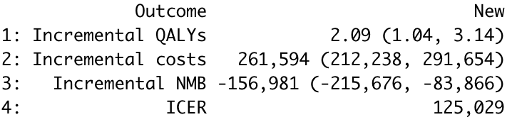
Incremental cost-effectiveness ratio with hesim
icer(cea_pw_out2, wtp = 50000) %>%
format()

Slide 75
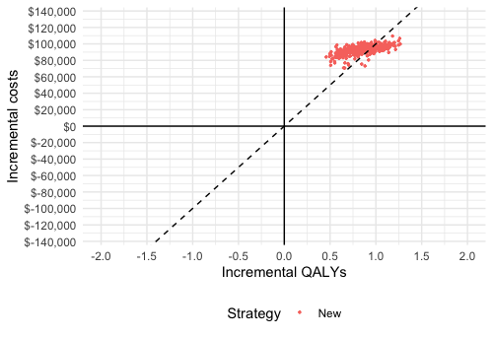
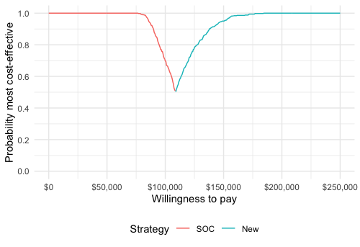
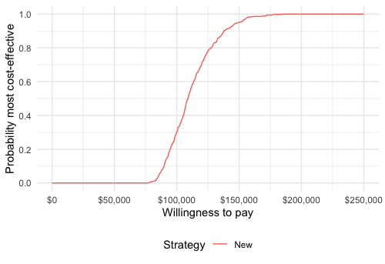
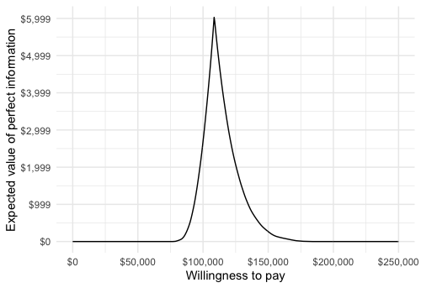
Representing decision uncertainty with hesim
plot_ceplane(cea_pw_out2)
plot_ceaf(cea_out2)
plot_ceac(cea_pw_out2)
plot_evpi(cea_out2)

Slide 76
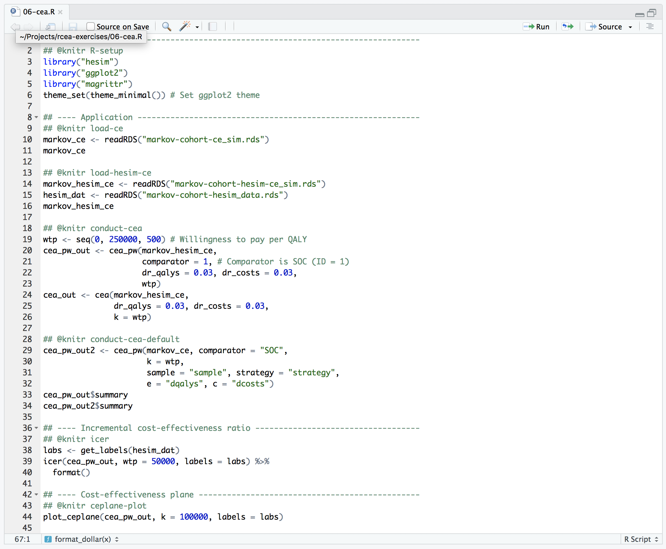
Complete R script

Slide 77
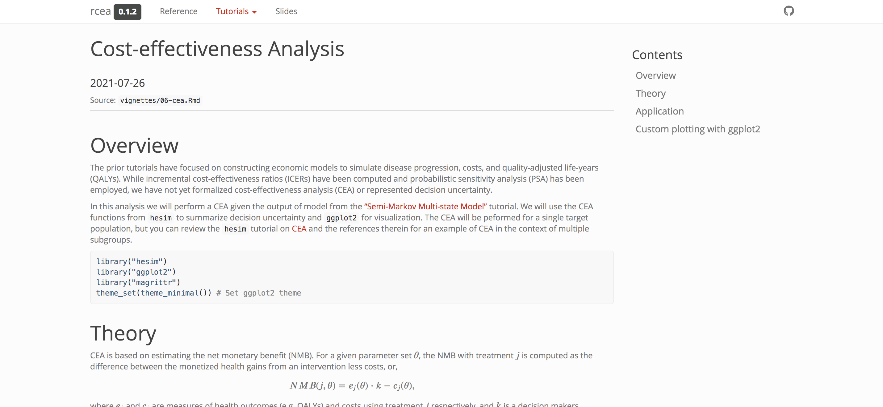
Tutorial
https://hesim-dev.github.io/rcea/articles/06-cea.html

Slide 78
Exercise 3: Cost-effectiveness analysis
Review and run the R-script “06-cea.R”

Slide 79
Day 2

Slide 80
Simple Markov cohort model with hesim

Slide 81
What is hesim?
A modular and computationally efficient R package for building simulation models for economic evaluation
Supports both cohort and individual-level models, encompassing Markov (time-homogeneous and time-inhomogeneous) and semi-Markov processes
cohort discrete time state transition models (cDTSTM)
individual-level continuous time state transition models (iCTSTM)
n-state partitioned survival models (PSM)
Parameterization by fitting a statistical model in R or by using estimates from external sources
Nearly all simulation code written in C++ under the hood, but you don’t need to know C++ to use it!

Slide 82
hesim modeling process

Slide 83
Economic models with hesim
Model set-up
Parameters
Simulation
Construction of model
Simulation of outcomes
Cost-effectiveness analysis

Slide 84
Model setup
Define target population and intervention strategies
strategies <- data.frame(
strategy_id = 1:2,
strategy_name = c("SOC", "New")
)
patients <- data.frame(
patient_id = 1,
age = 25
)
hesim_dat <- hesim_data(
strategies = strategies,
patients = patients
)
print(hesim_dat)
$strategies
strategy_id strategy_name
1 1 SOC
2 2 New
$patients
patient_id age
1 1 25
attr(,"class")
[1] "hesim_data"
labs <- get_labels(hesim_dat)

Slide 85
Model parameters
Same list of parameters as used before
params <- list(
alpha_soc = transitions_soc,
lrr_mean = log(.8),
lrr_lower = log(.71),
lrr_upper = log(.9),
c_medical = c(H = 2000, S1 = 4000, S2 = 15000),
c_soc = 2000,
c_new = 12000,
u_mean = c(H = 1, S1 = .75, S2 = 0.5),
u_se = c(H = 0, S1 = 0.03, S2 = 0.05)
)

Slide 86
Model parameters – Random number generation (for PSA)
rng_def <- define_rng({
lrr_se <- (lrr_upper - lrr_lower)/(2 * qnorm(.975))
list( # Parameters to return
p_soc = dirichlet_rng(alpha_soc),
rr_new = lognormal_rng(lrr_mean, lrr_se),
c_medical = gamma_rng(mean = c_medical, sd = c_medical),
c_soc = c_soc,
c_new = c_new,
u = beta_rng(mean = u_mean, sd = u_se)
)
}, n = 1000)

Slide 87
Model parameters – Transformed parameters
Typically underlying parameters (params) are transformed (tparams) into more relevant parameters for the simulation
e.g., predicting an element of a transition probability matrix as a function of the treatment strategy
We previously did this in the base R PSA example…

Slide 88
sim_model <- function(params_rng, data, n_cycles = 85, dr_qalys = .03, dr_costs = .03){
# Initialize array of matrices
n_samples <- attr(params_rng, "n")
n_strategies <- nrow(data)
out <- array(NA, dim = c(n_cycles + 1, 7, n_samples * n_strategies))
dimnames(out) <- list(NULL, c("H", "S1", "S2", "D", "dqalys", "dcosts_med", "dcosts_treat"), NULL)
# Run the simulation
i <- 1
for (s in 1:n_samples){ # Start PSA loop
for (k in 1:n_strategies) { # Start treatment strategy loop
x <- sim_stateprobs(p0 = params_rng$p_soc[s, ],
rr = params_rng$rr_new[s],
strategy = data$strategy[k],
n_cycles = n_cycles)
dqalys <- compute_qalys(x, utility = unlist(params_rng$u[s]),dr = dr_qalys)
dcosts <- compute_costs(x,
costs_medical = unlist(params_rng$c_medical[s]),
costs_treat = ifelse(data$strategy[k] == "SOC",
params_rng$c_soc,
params_rng$c_new), dr = dr_costs)
out[, , i] <- cbind(x, dqalys, dcosts)
i <- i + 1
} # End treatment strategy loop
} # End PSA loop
# Store metadata and return
attr(out, "n_samples") <- n_samples
attr(out, "strategies") <- data$strategy
return(out)
}
sim_out <- sim_model(params_rng, data = data)
sim_out <- array_to_dt(sim_out)

Slide 89
sim_stateprobs <- function(p0, rr, strategy, n_cycles){
rr <- ifelse(strategy == "New", rr, 1)
p <- tpmatrix(
C, p0$h_s1 * rr, p0$h_s2 * rr, p0$h_d * rr,
p0$s1_h, C, p0$s1_s2 * rr, p0$s1_d * rr,
p0$s2_h, p0$s2_s1, C, p0$s2_d * rr,
0, 0, 0, 1
)
x <- sim_markov_chain(x0 = c(1, 0, 0, 0),
p = matrix(as.matrix(p), ncol = 4, byrow = TRUE),
n_cycles = n_cycles)
return(x)
}

Slide 90
Model parameters – Transformed parameters
A define_tparams() block in hesim does the same thing, but most of the implementation is done for you (efficiently)
A define_tparams() block returns:
tpmatrix: The transition probability matrix
utility: Utility assigned to each health state
costs: Costs assigned to each health state for each cost category
All parameters are “transformed” using:
Columns of input data
Parameters returned by define_rng()

Slide 91
Model parameters – Transformed parameters
Input data (treatment strategies and patients) can be generated using expand()¹
input_data <- expand(hesim_dat, by = c("strategies", "patients"))
head(input_data)
strategy_id patient_id strategy_name age
1: 1 1 SOC 25
2: 2 1 New 25
¹Could also be expanded by time intervals in a time-inhomogeneous model

Slide 92
Model parameters – Transformed parameters
You write mathematical expressions
Vectorized over PSA iterations and input data rows
tparams_def <- define_tparams({
# The treatment effect (relative risk) varies by
# strategies (SOC is the reference strategy)
rr <- ifelse(strategy_name == "SOC", 1, rr_new)
list(
tpmatrix = tpmatrix(
C, p_soc$h_s1 * rr, p_soc$h_s2 * rr, p_soc$h_d * rr,
p_soc$s1_h, C, p_soc$s1_s2 * rr, p_soc$s1_d * rr,
p_soc$s2_h, p_soc$s2_s1, C, p_soc$s2_d * rr,
0, 0, 0, 1
),
utility = u,
costs = list(
treatment = ifelse(strategy_name == "SOC", c_soc, c_new),
medical = c_medical
)
)
})
tpmatrix() is a powerful function for creating/storing transition probabilities that vary across PSA samples, strategies, subgroups, and time intervals
Input data
Parameter
Parameter (defined above)
Parameter
C denotes the “complement”, ensuring that the probabilities in a row sum to 1
Input data
Parameter
Parameter

Slide 93
Simulation - Construct the model
Combine the underlying parameters with the expressions for random number generation and parameter transformation
A economic model (of class CohortDtstm) can be created from a defined model (of class model_def) and data using the generic function create_CohortDtstm()
This object consists of a
transition model for simulating transition probabilities with $sim_stateprobs()
a utility model for simulating quality-adjusted life-years with $sim_qalys()
a set of cost models (for each cost category) for simulating costs with $sim_costs()
mod_def <- define_model(tparams_def = tparams_def,
rng_def = rng_def,
params = params)
econmod <- create_CohortDtstm(mod_def, input_data)

Slide 94
Simulation – Simulating outcomes
sample strategy_id patient_id grp_id state_id t prob
1: 1 1 1 1 1 0 1.0000000
2: 1 1 1 1 1 1 0.8466964
3: 1 1 1 1 1 2 0.7929241
4: 1 1 1 1 1 3 0.7652357
5: 1 1 1 1 1 4 0.7446251
6: 1 1 1 1 1 5 0.7261680
Health state probabilities
QALYs
Costs
econmod$sim_stateprobs(n_cycles = 85)
sample strategy_id patient_id grp_id state_id dr qalys lys
1: 1 1 1 1 1 0.03 14.604941 14.604941
2: 1 1 1 1 2 0.03 2.718281 3.660628
3: 1 1 1 1 3 0.03 2.595318 7.331531
4: 1 2 1 1 1 0.03 17.633196 17.633196
5: 1 2 1 1 2 0.03 2.632315 3.544860
6: 1 2 1 1 3 0.03 2.083739 5.886368
econmod$sim_qalys(
dr = 0.03, lys = TRUE,
integrate_method = "riemann_right”
)
econmod$sim_costs(
dr = 0.03,
integrate_method = "riemann_right”
)
sample strategy_id patient_id grp_id state_id dr category costs
1: 1 1 1 1 1 0.03 treatment 29209.882
2: 1 1 1 1 2 0.03 treatment 7321.257
3: 1 1 1 1 3 0.03 treatment 14663.061
4: 1 2 1 1 1 0.03 treatment 211598.347
5: 1 2 1 1 2 0.03 treatment 42538.323
6: 1 2 1 1 3 0.03 treatment 70636.410

Slide 95
Cost-effectiveness analysis
CEAs can be performed directly from the simulation output with hesim.
First we need to aggregate (i.e., ”summarize”) costs and QALYs across health states
$costs
category dr sample strategy_id costs grp_id
1: treatment 0.03 1 1 51194.20 1
2: treatment 0.03 1 2 324773.08 1
3: treatment 0.03 2 1 48720.41 1
4: treatment 0.03 2 2 316828.55 1
5: treatment 0.03 3 1 51943.80 1
---
5996: total 0.03 998 2 402500.90 1
5997: total 0.03 999 1 197991.68 1
5998: total 0.03 999 2 461755.98 1
5999: total 0.03 1000 1 203541.38 1
6000: total 0.03 1000 2 461558.77 1
$qalys
dr sample strategy_id qalys grp_id
1: 0.03 1 1 19.91854 1
2: 0.03 1 2 22.34925 1
3: 0.03 2 1 19.87522 1
4: 0.03 2 2 22.71959 1
5: 0.03 3 1 21.39403 1
---
1996: 0.03 998 2 23.08819 1
1997: 0.03 999 1 21.25388 1
1998: 0.03 999 2 22.98019 1
1999: 0.03 1000 1 20.75811 1
2000: 0.03 1000 2 23.84501 1
attr(,"class")
[1] "ce"
ce_sim <- econmod$summarize()

Slide 96
Cost-effectiveness analysis
Here, we will consider a pairwise comparison between the new treatment and SOC with the cea_pw() function
cea_pw_out <- cea_pw(ce_sim, comparator = 1,
dr_qalys = 0.03, dr_costs = 0.03,
k = seq(0, 25000, 500))
Although cea_pw() allows users to summarize output from a PSA we will just create an ICER table using means for now
format(icer(cea_pw_out, k = 50000, labels = labs))
Outcome New
1: Incremental QALYs 2.07 (1.05, 3.13)
2: Incremental costs 257,297 (203,094, 284,985)
3: Incremental NMB -153,833 (-210,941, -77,824)
4: ICER 124,342

Slide 97
Steps with hesim
Model set-up
Specify the treatment strategies and target population(s)
hesim_data()
Parameters
Estimate or define the parameters of the economic model
define_rng(), define_tparams()
Simulation
Construction of model
Create an economic model—consisting of separate statistical models for disease progression, costs, and utilities—that simulate outcomes as a function of input data (derived from Step 1) and parameters (from Step 2)
define_model(), create_CohortDtstm()
Simulation of outcomes
Simulate outcomes (disease progression, costs, and quality-adjusted life-years (QALYs)) using the model constructed in Step 3
$sim_stateprobs(), $sim_qalys(), $sim_costs()
Cost-effectiveness analysis

Slide 98
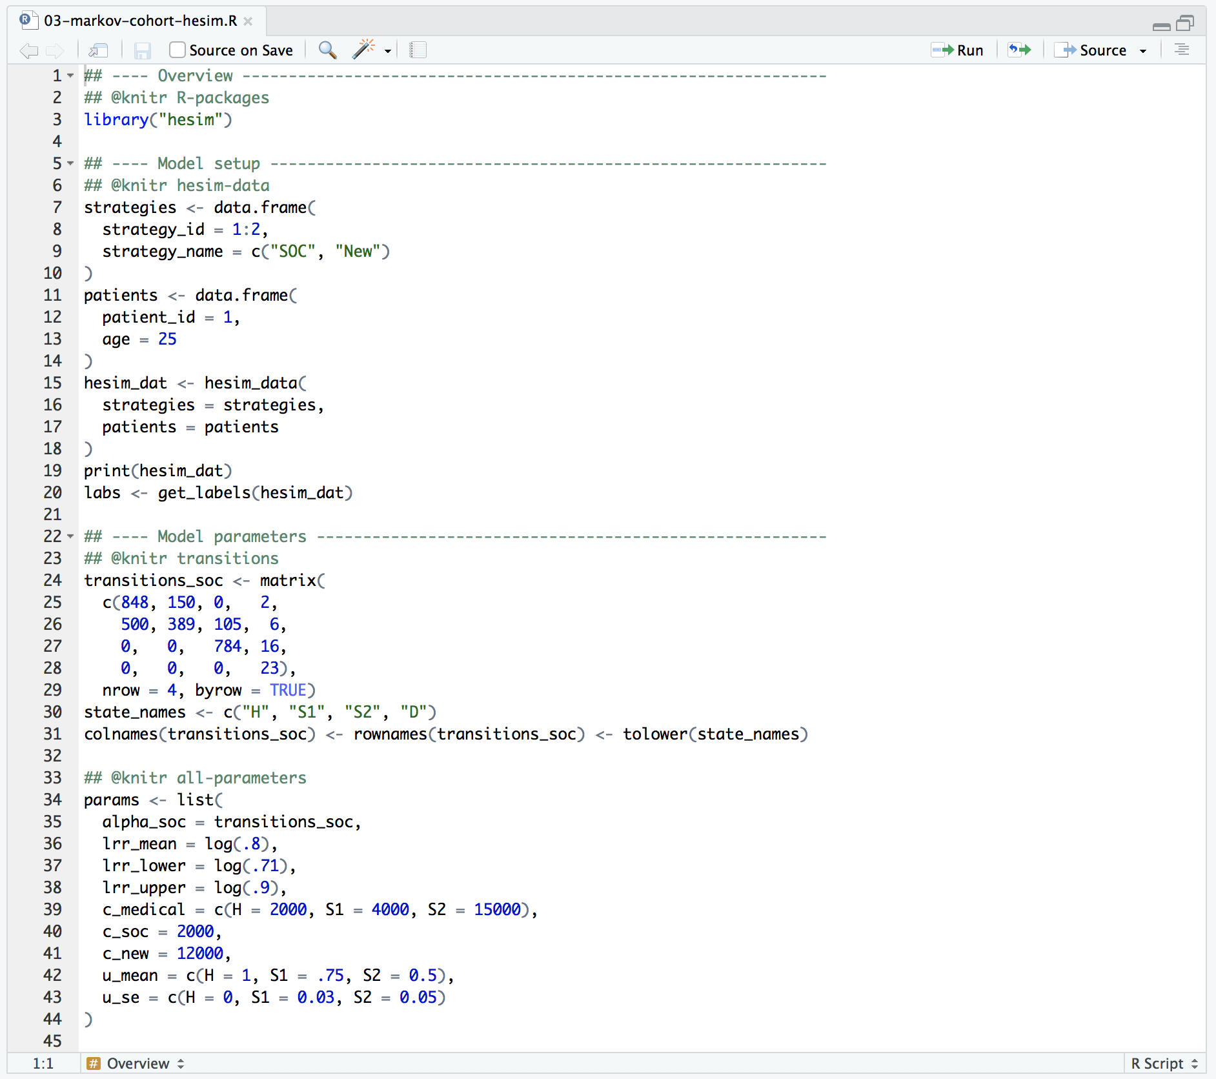
Complete R script

Slide 99
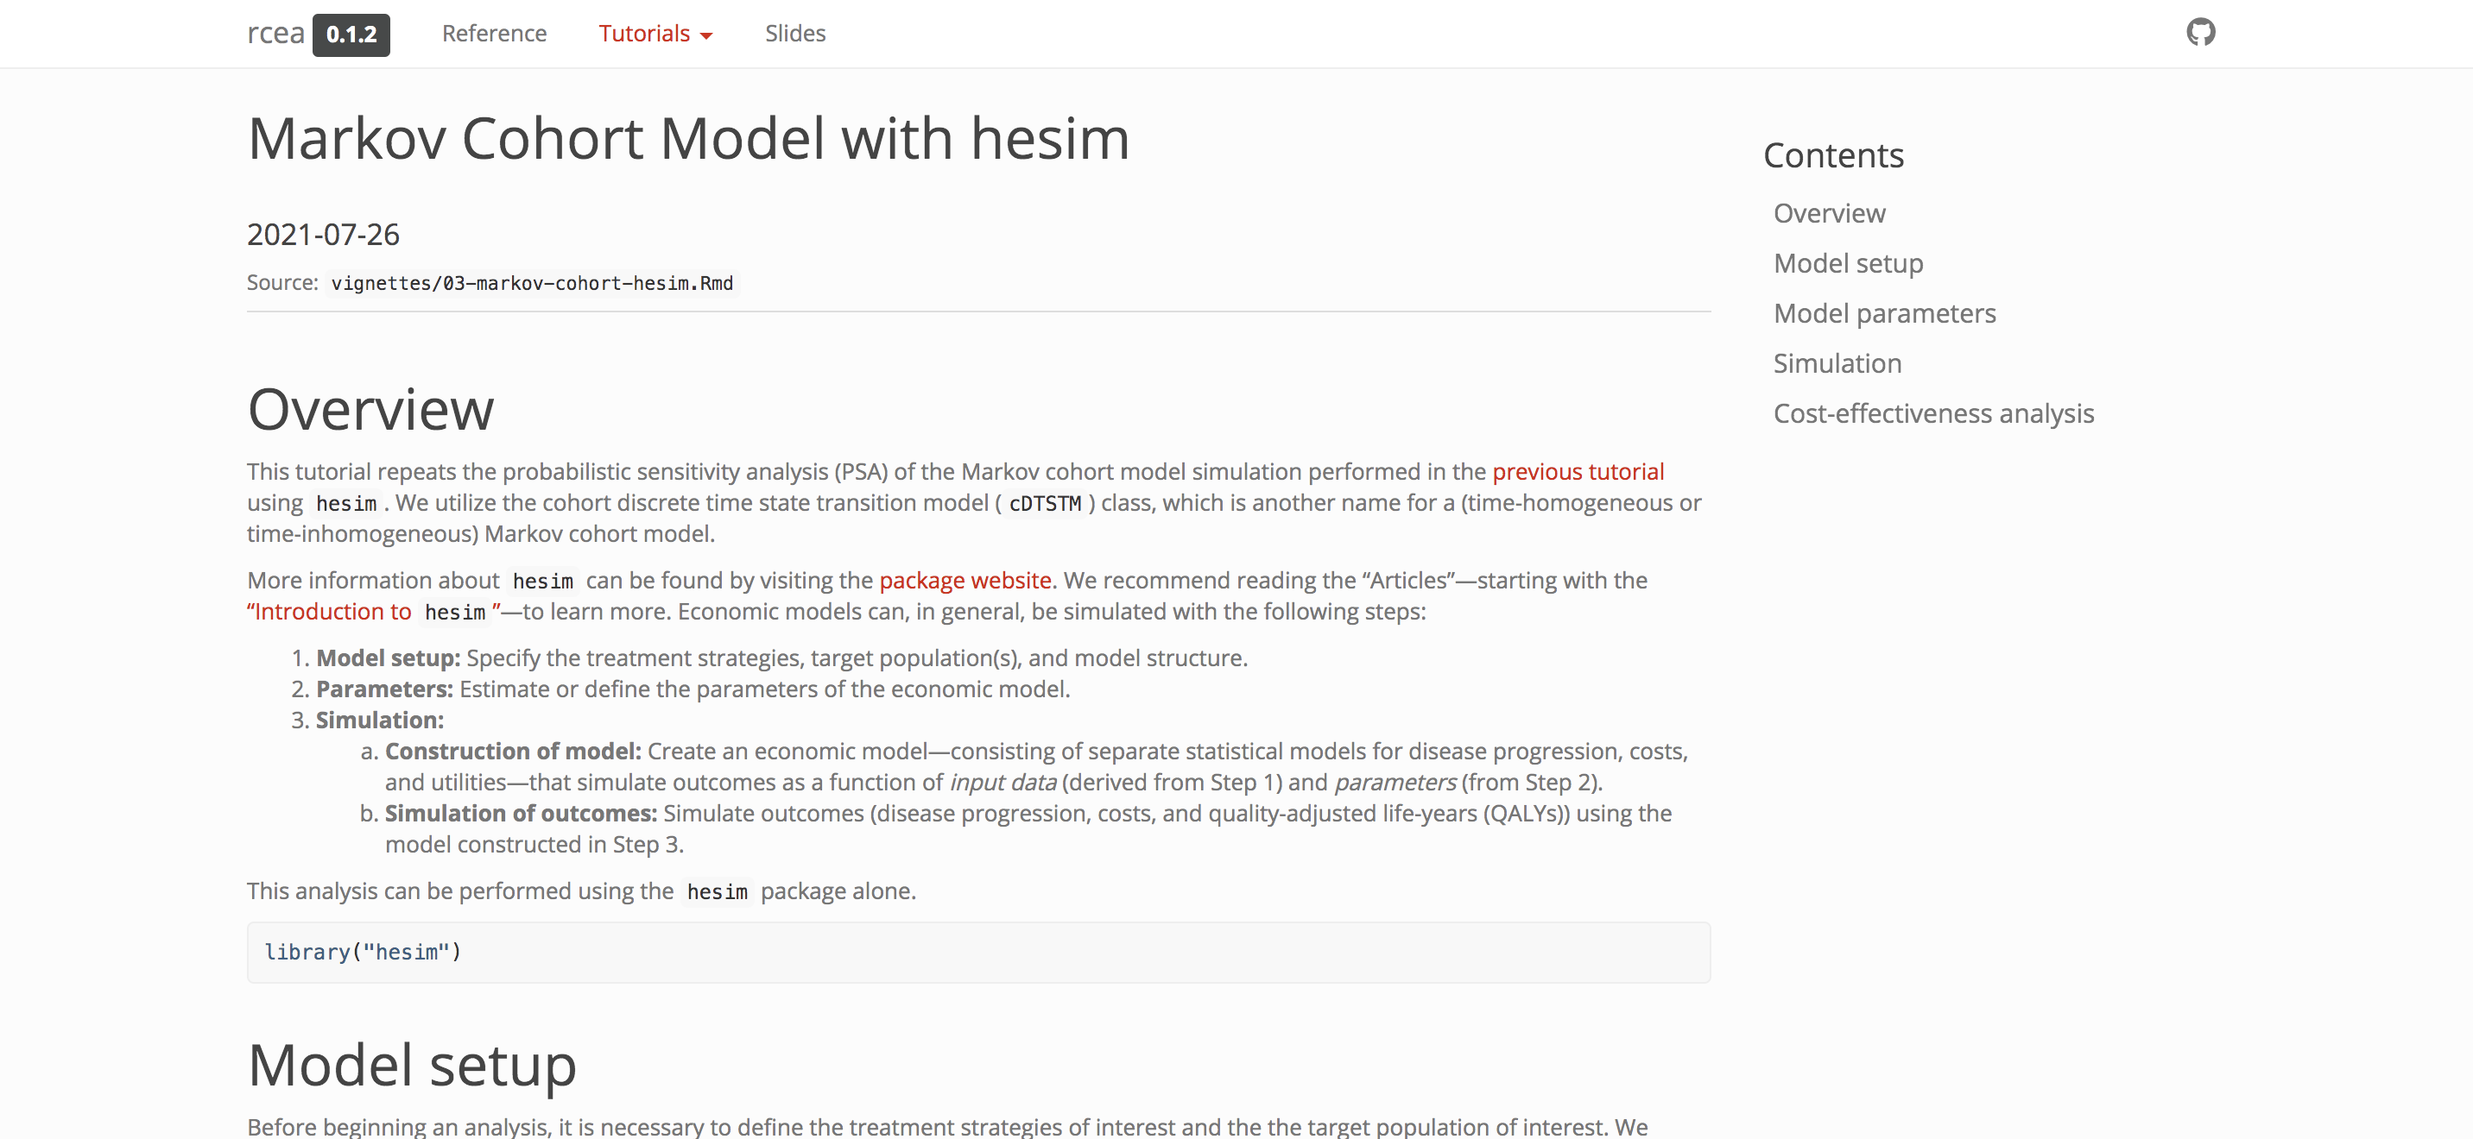
Tutorial
https://hesim-dev.github.io/rcea/articles/03-markov-cohort-hesim.html

Slide 100
Exercise 4: Markov cohort model with hesim
Modify R-script “03-markov-cohort-hesim.R”
Increase confidence interval for relative risk
Modify the mean health state utility value
Remove impact of the intervention on transitions from “healthy” to “sick”, “sicker” , and “death” (row 72)
Run modified script
tparams_def <- define_tparams({
## The treatment effect (relative risk) is transformed so that it varies by
## strategies (SOC is the reference strategy)
rr <- ifelse(strategy_name == "SOC", 1, rr_new)
list(
tpmatrix = tpmatrix(
C, p_soc$h_s1 * rr, p_soc$h_s2 * rr, p_soc$h_d * rr,
p_soc$s1_h, C, p_soc$s1_s2 * rr, p_soc$s1_d * rr,
p_soc$s2_h, p_soc$s2_s1, C, p_soc$s2_d * rr,
0, 0, 0, 1
),
utility = u,
costs = list(
treatment = ifelse(strategy_name == "SOC", c_soc, c_new),
medical = c_medical
)
)
})

Slide 101
Semi-Markov multi-state model

Slide 102
Semi-Markov multi-state model
Transition rates can depend on time in intermediate health states (unlike in a Markov model)
Can only be simulated in a general manner using individual patient simulation (IPS)
IPS is performed most efficiently using a continuous time state transition model (CTSTM)
Ideally parameterizing by fitting a multi-state model

Slide 103
Semi-Markov multi-state model
Clock reset

Slide 104
Economic models with hesim
Model set-up
Parameters
Simulation
Construction of model
Simulation of outcomes
Cost-effectiveness analysis

Slide 105
Model setup
The transitions of a multi-state model in hesim must be characterized by a matrix where each element denotes a transition from a row to a column
tmat <- rbind(
c(NA, 1, 2),
c(NA, NA, 3),
c(NA, NA, NA)
)
colnames(tmat) <- rownames(tmat) <- c("Stable", "Progression", "Dead")
print(tmat)
Stable Progression Dead
Stable NA 1 2
Progression NA NA 3
Dead NA NA NA

Slide 106
Model setup
n_patients <- 1000
patients <- data.table(
patient_id = 1:n_patients,
age = rnorm(n_patients, mean = 45, sd = 7),
female = rbinom(n_patients, size = 1, prob = .51)
)
strategies <- data.frame(
strategy_id = 1:2,
strategy_name = c("SOC", "New")
)
n_strategies <- nrow(strategies)
As in the cohort model, we must specify the target population and treatment strategies of interest
In an IPS we simulate many patients and then average outcomes across the simulated patients. 1,000 simulated patients should produce reasonably stable results
We also explicitly define the (non-death) health states, which we will use to model utility and costs
states <- data.table(
state_id = c(1, 2),
state_name = c("Stable", "Progression")
)
n_states <- nrow(states)
hesim_dat <- hesim_data(
strategies = strategies,
patients = patients,
states = states
)
We always combine this information into one object

Slide 107
Model setup
$strategies
strategy_id strategy_name
1 1 SOC
2 2 New
$patients
patient_id age female
1: 1 42.71774 0
2: 2 48.86723 0
3: 3 40.27539 1
4: 4 46.50052 1
5: 5 47.17538 1
---
996: 996 43.22279 0
997: 997 54.22166 0
998: 998 37.27172 0
999: 999 45.20616 0
1000: 1000 39.15981 1
$states
state_id state_name
1: 1 Stable
2: 2 Progression
attr(,"class")
[1] "hesim_data"
print(hesim_dat)
labs <- get_labels(hesim_dat)

Slide 108
Parameter estimation
In the cohort examples, we used parameter estimates from the literature
We will continue to do this for utility and costs
However, in an ideal scenario, we would estimate parameters ourselves using patient-level data
We will fit a multi-state model in this manner by estimating transition specific hazards using the R package flexsurv

Slide 109
Parameter estimation – Multi-state model
Multi-state models can be fit by:
Estimating a joint survival model with interaction terms for different transition
Fitting separate survival models for each transition
(Method used here)

Slide 110
Parameter estimation – Multi-state model
from to strategy_name female age patient_id time_start
1: Stable Progression New 0 59.85813 1 0.000000
2: Stable Death New 0 59.85813 1 0.000000
3: Progression Death New 0 59.85813 1 2.420226
4: Stable Progression New 0 62.57282 2 0.000000
5: Stable Death New 0 62.57282 2 0.000000
time_stop status transition_id strategy_id time
1: 2.420226 1 1 3 2.420226
2: 2.420226 0 2 3 2.420226
3: 14.620258 1 3 3 12.200032
4: 7.497464 0 1 3 7.497464
5: 7.497464 0 2 3 7.497464
Dataset
Estimate parameters
wei_fits <- vector(length = 3, mode = "list")
for (i in 1:3){ # 3 possible transitions
wei_fits[[i]] <- flexsurvreg(
Surv(time, status) ~ strategy_name + female,
data = data,
subset = (transition_id == i) ,
dist = "weibull")
}
wei_fits <- flexsurvreg_list(wei_fits)

Slide 111
Parameter estimation – Multi-state model
Stable -> Progression
[[1]]
Call:
flexsurvreg(formula = Surv(time, status) ~ strategy_name + female,
data = data, subset = (transition_id == i), dist = "weibull")
Estimates:
data mean est L95% U95% se exp(est) L95% U95%
shape NA 2.0152 1.9226 2.1124 0.0484 NA NA NA
scale NA 7.1668 6.7796 7.5762 0.2031 NA NA NA
strategy_nameNew 0.5281 0.2745 0.2131 0.3360 0.0314 1.3159 1.2375 1.3994
female 0.4947 -0.1902 -0.2518 -0.1286 0.0314 0.8268 0.7774 0.8793
N = 1975, Events: 1006, Censored: 969
Total time at risk: 9192.058
Log-likelihood = -2906.248, df = 4
AIC = 5820.497
New treatment increases time to progression (AFT model)
Shape parameter: whether the hazard is increasing (>1), decreasing (<1), or constant (=1)
Scale: whether the hazard is lower/higher at given time point

Slide 112
Parameter estimation – Multi-state model
Stable -> Death
[[2]]
Call:
flexsurvreg(formula = Surv(time, status) ~ strategy_name + female,
data = data, subset = (transition_id == i), dist = "weibull")
Estimates:
data mean est L95% U95% se exp(est) L95% U95%
shape NA 2.482459 2.303776 2.675000 0.094614 NA NA NA
scale NA 10.406898 9.612760 11.266641 0.421473 NA NA NA
strategy_nameNew 0.528101 0.241482 0.157695 0.325268 0.042749 1.273134 1.170810 1.384402
female 0.494684 -0.083337 -0.167300 0.000626 0.042839 0.920041 0.845945 1.000626
N = 1975, Events: 358, Censored: 1617
Total time at risk: 9192.058
Log-likelihood = -1333.968, df = 4
AIC = 2675.936
Shape parameter: whether the hazard is increasing, decreasing, or constant
Scale: whether the hazard is lower/higher at given time point

Slide 113
Parameter estimation – Multi-state model
Progression -> Death
[[3]]
Call:
flexsurvreg(formula = Surv(time, status) ~ strategy_name + female,
data = data, subset = (transition_id == i), dist = "weibull")
Estimates:
data mean est L95% U95% se exp(est) L95% U95%
shape NA 3.48340 3.25461 3.72826 0.12074 NA NA NA
scale NA 8.96768 8.55835 9.39658 0.21376 NA NA NA
strategy_nameNew 0.50398 0.00922 -0.04311 0.06155 0.02670 1.00926 0.95780 1.06348
female 0.52386 -0.11650 -0.16914 -0.06385 0.02686 0.89003 0.84439 0.93815
N = 1006, Events: 468, Censored: 538
Total time at risk: 5479.46
Log-likelihood = -1237.573, df = 4
AIC = 2483.147
Shape parameter: whether the hazard is increasing, decreasing, or constant
Scale: whether the hazard is lower/higher at given time point

Slide 114
Parameters – Utility
utility_tbl <- stateval_tbl(
data.table(state_id = states$state_id,
mean = c(.8, .6),
se = c(0.02, .05)
),
dist = "beta",
hesim_data = hesim_dat)
state_id mean se
1: 1 0.8 0.02
2: 2 0.6 0.05

Slide 115
Parameters – Medical cost
medcost_tbl <- stateval_tbl(
data.table(state_id = states$state_id,
mean = c(2000, 9500),
se = c(2000, 9500)
),
dist = "gamma",
hesim_data = hesim_dat)
state_id mean se
1: 1 2000 2000
2: 2 9500 9500

Slide 116
Parameters – Drug cost
n_times <- 2
drugcost_tbl <- stateval_tbl(
data.table(
strategy_id = rep(strategies$strategy_id, each = n_states * n_times),
state_id = rep(rep(states$state_id, each = n_strategies), n_times),
time_start = rep(c(0, 3/12), n_states * n_strategies),
est = c(rep(2000, 4), # Costs are always the same with SOC
12000, 12000, 12000, 10000 # Costs with New drop after 3 months in progression state
)
),
dist = "fixed",
hesim_data = hesim_dat)
When using an IPS, ”state values” (like transition rates) can depend on time in an intermediate health state
We illustrate by assuming that costs for the new treatment are $12,000 for the first 3 months in the progression state and then $10,000 thereafter
(Would not be possible in a cohort model without creating tunnel states)
strategy_id state_id time_id time_start time_stop est
1: 1 1 1 0.00 0.25 2000
2: 1 1 2 0.25 Inf 2000
3: 1 2 1 0.00 0.25 2000
4: 1 2 2 0.25 Inf 2000
5: 2 1 1 0.00 0.25 12000
6: 2 1 2 0.25 Inf 12000
7: 2 2 1 0.00 0.25 12000
8: 2 2 2 0.25 Inf 10000

Slide 117
Simulation – Construct the model Disease model
The transition model is constructed as a function of the fitted multi-state model and input data (treatment strategy and patients)
transmod_data <- expand(hesim_dat,
by = c("strategies", "patients"))
strategy_id patient_id strategy_name age female
1: 1 1 SOC 42.71774 0
2: 1 2 SOC 48.86723 0
3: 1 3 SOC 40.27539 1
4: 1 4 SOC 46.50052 1
5: 1 5 SOC 47.17538 1
6: 1 6 SOC 53.21776 0
transmod <- create_IndivCtstmTrans(wei_fits, transmod_data,
trans_mat = tmat, n = 500,
clock = "reset",
start_age = patients$age)

Slide 118
Simulation – Construct the model Utility and cost models
# Utility
utilitymod <- create_StateVals(utility_tbl, n = 500,
hesim_data = hesim_dat)
# Costs
drugcostmod <- create_StateVals(drugcost_tbl, n = 500,
time_reset = TRUE,
hesim_data = hesim_dat)
medcostmod <- create_StateVals(medcost_tbl, n = 500,
hesim_data = hesim_dat)
costmods <- list(Drug = drugcostmod,
Medical = medcostmod)
So that costs depend on time in intermediate state

Slide 119
Simulation – Construct the model Combining the disease progression, cost, and utility models
econmod <- IndivCtstm$new(trans_model = transmod,
utility_model = utilitymod,
cost_models = costmods)

Slide 120
Simulation - Simulating outcomes Disease progression
econmod$sim_disease(max_age = 100)
head(econmod$disprog_)
sample strategy_id patient_id grp_id from to final time_start time_stop
1: 1 1 1 1 1 2 0 0.000000 1.420130
2: 1 1 1 1 2 3 1 1.420130 11.238494
3: 1 1 2 1 1 2 0 0.000000 5.711780
4: 1 1 2 1 2 3 1 5.711780 17.169136
5: 1 1 3 1 1 2 0 0.000000 5.249609
6: 1 1 3 1 2 3 1 5.249609 9.059670
econmod$sim_stateprobs(t = seq(0, 30 , 1/12))
autoplot(econmod$stateprobs_, labels = labs)

Slide 121
Simulation - Simulating outcomes QALYs and costs
econmod$sim_qalys(dr = c(0,.03))
sample strategy_id grp_id state_id dr qalys lys
1: 1 1 1 1 0 3.795199 5.009791
2: 1 1 1 2 0 3.433499 5.368864
3: 1 2 1 1 0 4.898627 6.466354
4: 1 2 1 2 0 3.491527 5.459601
5: 2 1 1 1 0 3.882274 4.793997
6: 2 1 1 2 0 3.220405 5.746082
econmod$sim_costs(dr = 0.03)
sample strategy_id grp_id state_id dr category costs
1: 1 1 1 1 0.03 Drug 9124.834
2: 1 1 1 2 0.03 Drug 8261.846
3: 1 2 1 1 0.03 Drug 69025.893
4: 1 2 1 2 0.03 Drug 40511.631
5: 2 1 1 1 0.03 Drug 8778.825
6: 2 1 1 2 0.03 Drug 8863.685

Slide 122
Cost-effectiveness analysis
ce_sim <- econmod$summarize()
cea_pw_out <- cea_pw(ce_sim, comparator = 1,
dr_qalys = .03, dr_costs = .03)
icer_tbl(cea_pw_out, colnames = strategies$strategy_name)
Outcome New
1: Incremental QALYs 0.86 (0.56, 1.17)
2: Incremental costs 92,981 (81,657, 101,697)
3: Incremental NMB -50,160 (-61,751, -38,254)
4: ICER 108,571

Slide 123
Steps with hesim
Model set-up
Specify the treatment strategies, target population(s), and model structure
hesim_data()
Parameters
Estimate or define the parameters of the economic model
flexsurvreg_list(), stateval_tbl()
Simulation
Construction of model
Create an economic model—consisting of separate statistical models for disease progression, costs, and utilities—that simulate outcomes as a function of input data (derived from Step 1) and parameters (from Step 2)
create_IndivCtstmTrans(), create_StateVals(), IndivCtstm$new()
Simulation of outcomes
Simulate outcomes (disease progression, costs, and quality-adjusted life-years (QALYs)) using the model constructed in Step 3
$sim_disease(), $sim_stateprobs(), $sim_qalys(), $sim_costs()
Cost-effectiveness analysis

Slide 124
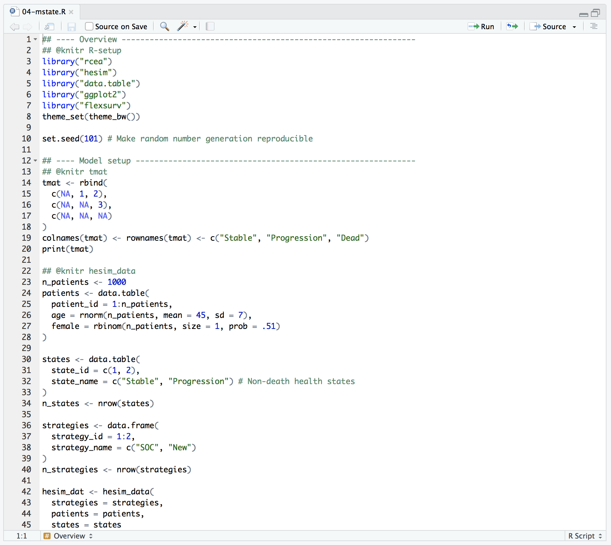
Complete R script

Slide 125
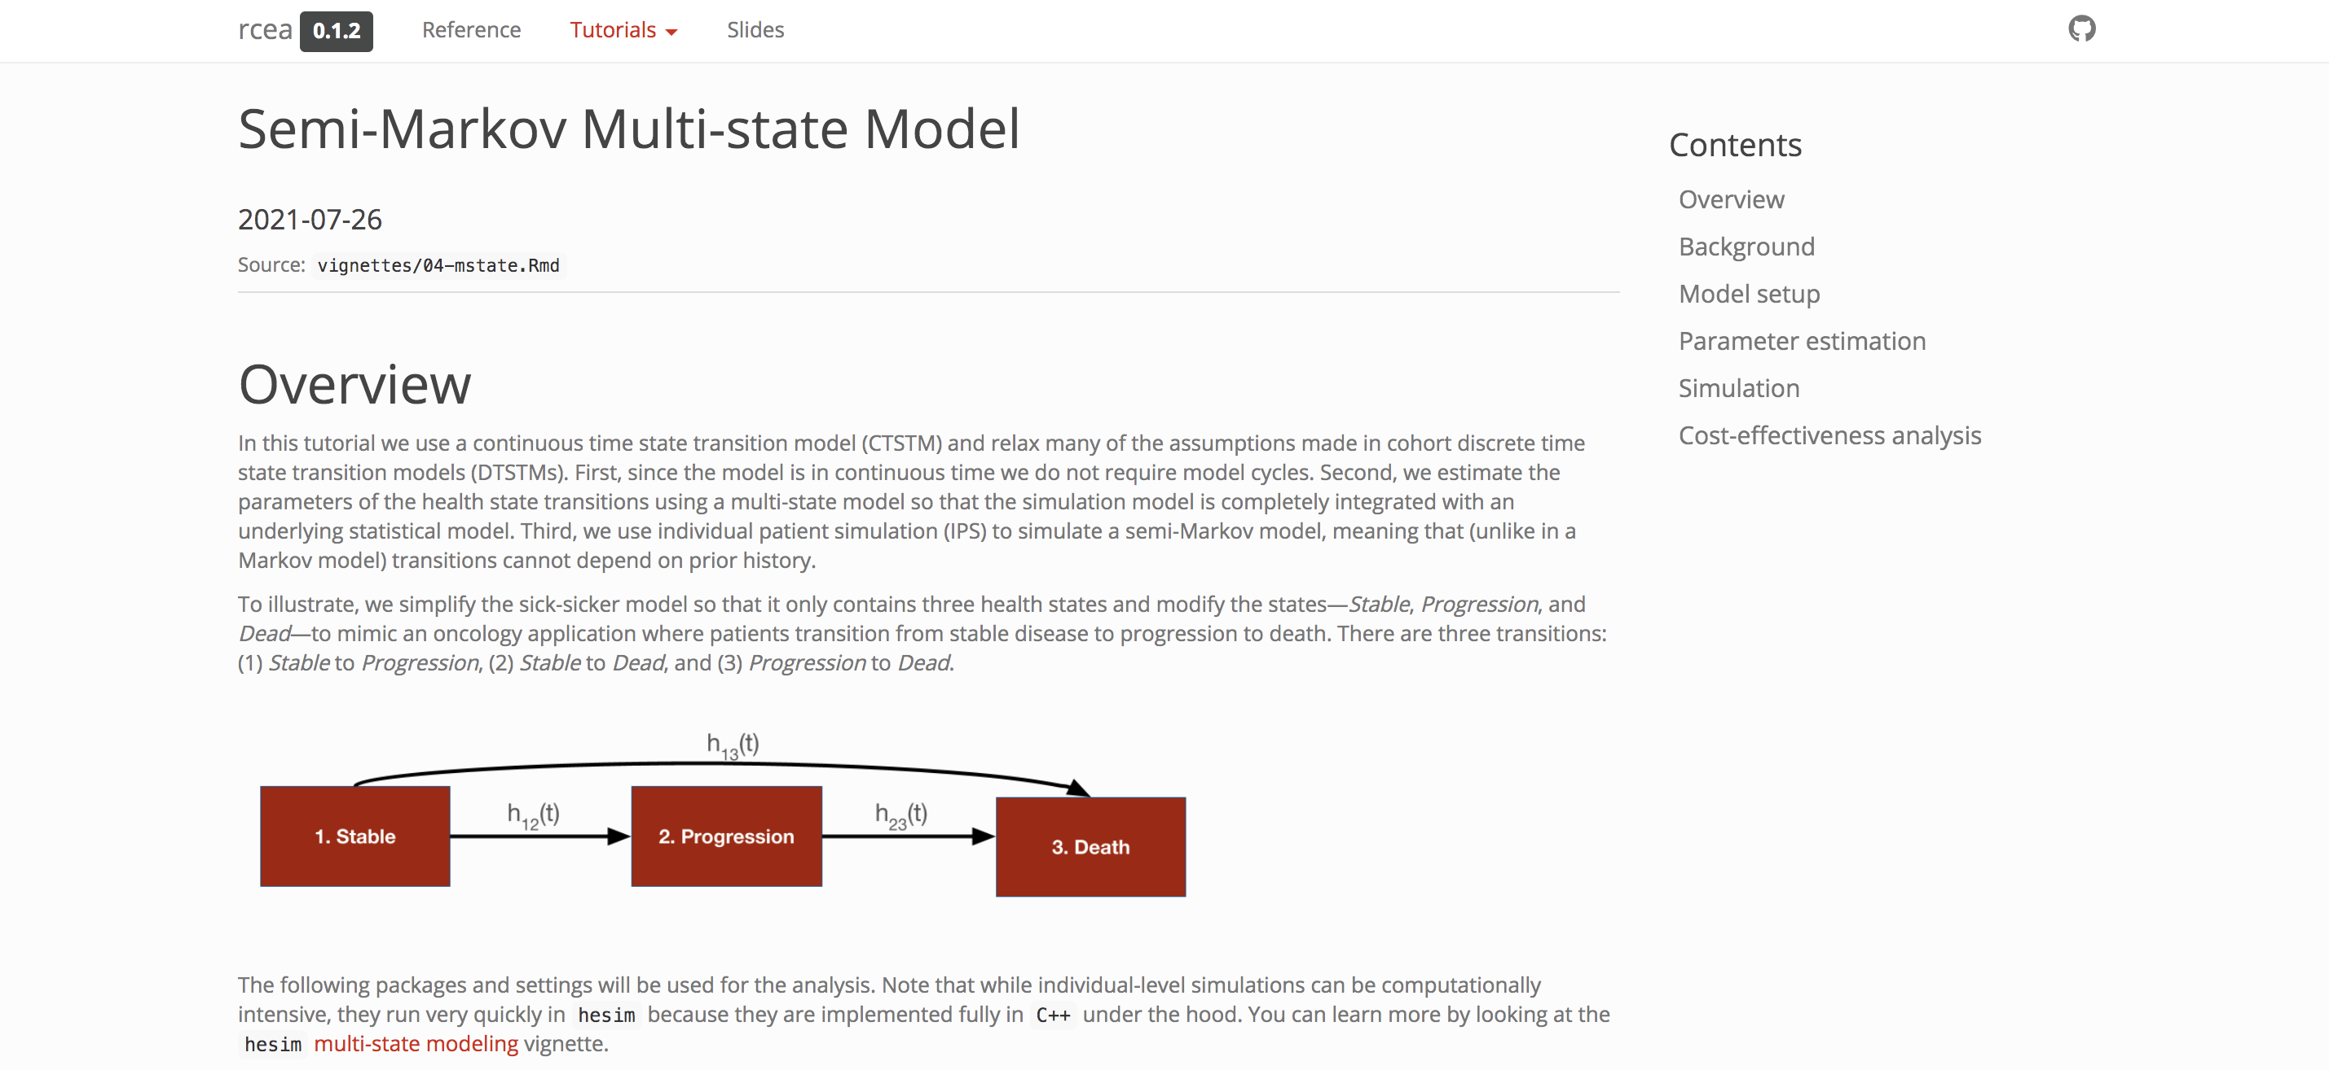
Tutorial
https://hesim-dev.github.io/rcea/articles/04-mstate.html

Slide 126
Exercise 5: Semi-Markov multi-state model
Review and run the R-script “04-mstate.R”

Slide 127
Partitioned survival model

Slide 128
Partitioned survival model
Source: Woods B, Sideris E, Palmer S, Latimer N, Soares M. NICE DSU Technical Support Document 19. Partitioned Survival Analysis for Decision Modelling in Health Care: A Critical Review. 2017 [Available from http://www.nicedsu.org.uk]

Slide 129
Economic models with hesim
Model set-up
Parameters
Simulation
Construction of model
Simulation of outcomes
Cost-effectiveness analysis

Slide 130
Model setup
patients <- data.table(
patient_id = 1:4,
patient_wt = rep(1/4, 4), # Each patient has same weight
age = c(45, 45, 65, 65),
female = c(0, 1, 0, 1)
)
states <- data.table(
state_id = c(1, 2),
state_name = c("Stable", "Progression") # Non-death health states
)
strategies <- data.frame(
strategy_id = 1:2,
strategy_name = c("SOC", "New")
)
hesim_dat <- hesim_data(
patients = patients,
strategies = strategies,
states = states
)
We set up the model in the same way as in the multi-state model, except that since PSMs are cohort models, we no longer need to simulate a large number of patients to compute expected values.
Instead, we will simulate separate cohorts of representative patients of varying ages and sexes.

Slide 131
Model setup
print(hesim_dat)
$strategies
strategy_id strategy_name
1 1 SOC
2 2 New
$patients
patient_id patient_wt age female
1: 1 0.25 45 0
2: 2 0.25 45 1
3: 3 0.25 65 0
4: 4 0.25 65 1
$states
state_id state_name
1: 1 Stable
2: 2 Progression
attr(,"class")
[1] "hesim_data"
labs <- get_labels(hesim_dat)

Slide 132
Parameter estimation – Survival models
PSMs are parameterized by estimating separate survival models for different endpoints (e.g. PFS and OS).
Dataset
patient_id female age strategy_name pfs_time pfs_status os_status os_time
1: 1 0 59.85813 New 2.420226 1 1 14.620258
2: 2 0 62.57282 New 7.497464 0 0 7.497464
3: 3 1 61.44379 SOC 2.365867 1 1 2.365867
4: 4 0 62.90770 New 9.342265 1 0 11.383095
5: 6 1 53.66665 New 9.922407 0 0 9.922407
Estimate parameters
fit_pfs_wei <- flexsurv::flexsurvreg(
Surv(pfs_time, pfs_status) ~ strategy_name + female,
data = surv_est_data,
dist = "weibull")
fit_os_wei <- flexsurvreg(
Surv(os_time, os_status) ~ strategy_name + female,
data = surv_est_data,
dist = "weibull")
psfit_wei <- flexsurvreg_list(fit_pfs_wei, fit_os_wei)
To maintain consistency with the multi-state model, we will fit Weibull survival models for both PFS and OS and include an indicator for female as a covariate.
The PFS and OS fits are stored in a flexsurvreg_list, which is just a list of models fit using flexsurvreg()

Slide 133
Parameters – Utility
utility_tbl <- stateval_tbl(
data.table(state_id = states$state_id,
mean = c(.8, .6),
se = c(0.02, .05)
),
dist = "beta”
)
state_id mean se
1: 1 0.8 0.02
2: 2 0.6 0.05

Slide 134
Parameters – Cost
medcost_tbl <- stateval_tbl(
data.table(state_id = states$state_id,
mean = c(2000, 9500),
se = c(2000, 9500)
),
dist = "gamma"
)
state_id mean se
1: 1 2000 2000
2: 2 9500 9500
drugcost_tbl <- stateval_tbl(
data.table(strategy_id = strategies$strategy_id,
est = c(2000, 12000)
),
dist = "fixed"
)
strategy_id est
1: 1 2000
2: 2 12000

Slide 135
Simulation – Construct the model Survival models
Survival predictions are made as a function of the fitted Weibull models and input data. The latter consists of each treatment strategy and patient combination.
survmods_data <- expand(hesim_dat, by = c("strategies", "patients"))
strategy_id patient_id strategy_name patient_wt age female
1: 1 1 SOC 0.25 45 0
2: 1 2 SOC 0.25 45 1
3: 1 3 SOC 0.25 65 0
4: 1 4 SOC 0.25 65 1
5: 2 1 New 0.25 45 0
6: 2 2 New 0.25 45 1
7: 2 3 New 0.25 65 0
8: 2 4 New 0.25 65 1
We must specify arguments related to the PSA.
We sample the parameters via bootstrapping, whereby the survival models are refit repeatedly to resamples of the estimation dataset. It preserves the correlation between PFS and OS and ensures that the curves do not cross.
survmods <- create_PsmCurves(psfit_wei,
input_data = survmods_data,
n = 100,
uncertainty = "bootstrap",
est_data = surv_est_data)

Slide 136
Simulation – Construct the model Utility and cost models
# Utility
utilitymod <- create_StateVals(utility_tbl, n = 100,
hesim_data = hesim_dat)
# Costs
drugcostmod <- create_StateVals(drugcost_tbl, n = 100,
hesim_data = hesim_dat)
medcostmod <- create_StateVals(medcost_tbl, n = 100,
hesim_data = hesim_dat)
costmods <- list(Drug = drugcostmod,
Medical = medcostmod)

Slide 137
Simulation – Construct the model Combining the disease progression, cost, and utility models
econmod <- Psm$new(trans_model = survmods,
utility_model = utilitymod,
cost_models = costmods)

Slide 138
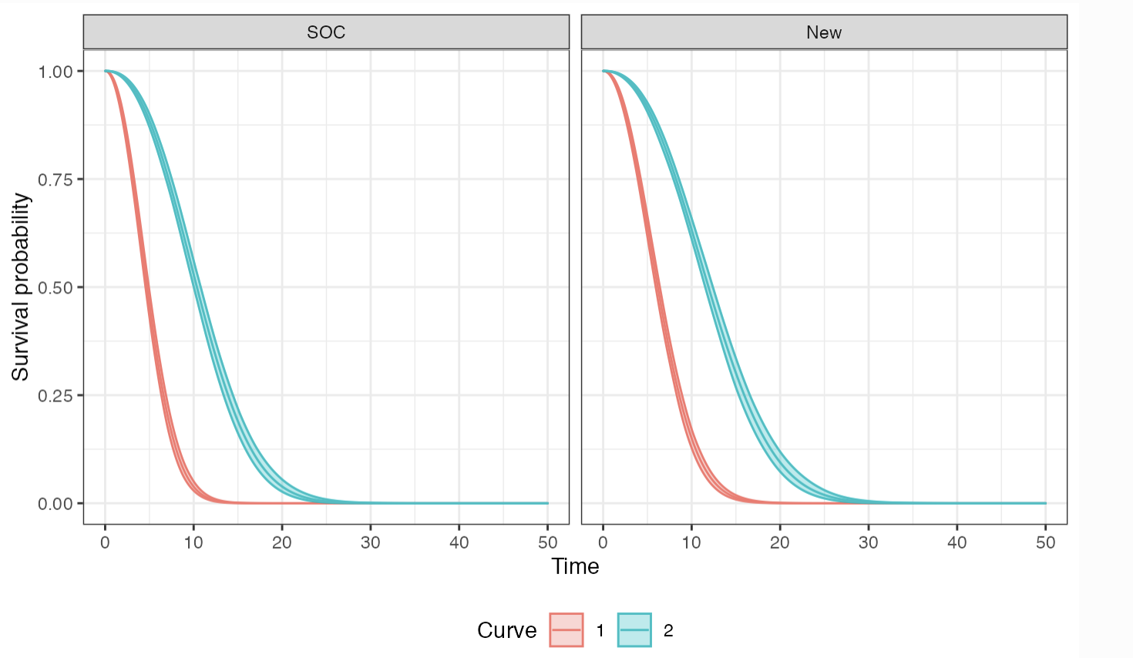
Simulation - Simulating outcomes Survival curves
times <- seq(0, 50, by = .1)
econmod$sim_survival(t = times)
autoplot(econmod$survival_, ci = TRUE,
labels = labs)

Slide 139
Simulation - Simulating outcomes Health state probabilities
econmod$sim_stateprobs()
sample strategy_id patient_id grp_id patient_wt state_id t prob
1: 1 1 1 1 0.25 1 0.0 1.0000000
2: 1 1 1 1 0.25 1 0.1 0.9998138
3: 1 1 1 1 0.25 1 0.2 0.9992079
4: 1 1 1 1 0.25 1 0.3 0.9981533
5: 1 1 1 1 0.25 1 0.4 0.9966344
---
1202396: 100 2 4 1 0.25 3 49.6 1.0000000
1202397: 100 2 4 1 0.25 3 49.7 1.0000000
1202398: 100 2 4 1 0.25 3 49.8 1.0000000
1202399: 100 2 4 1 0.25 3 49.9 1.0000000
1202400: 100 2 4 1 0.25 3 50.0 1.0000000

Slide 140
Simulation - Simulating outcomes QALYs and costs
econmod$sim_qalys(dr = 0.03)
sample strategy_id patient_id grp_id patient_wt state_id dr qalys lys
1: 1 1 1 1 0.25 1 0.03 3.954569 4.896886
2: 1 1 1 1 0.25 2 0.03 2.491677 4.092347
3: 1 1 2 1 0.25 1 0.03 3.406112 4.217740
4: 1 1 2 1 0.25 2 0.03 2.538972 4.170025
5: 1 1 3 1 0.25 1 0.03 3.954569 4.896886
6: 1 1 3 1 0.25 2 0.03 2.491677 4.092347
econmod$sim_costs(dr = 0.03)
sample strategy_id patient_id grp_id patient_wt state_id dr category costs
1: 1 1 1 1 0.25 1 0.03 Drug 9793.773
2: 1 1 1 1 0.25 2 0.03 Drug 8184.694
3: 1 1 2 1 0.25 1 0.03 Drug 8435.481
4: 1 1 2 1 0.25 2 0.03 Drug 8340.050
5: 1 1 3 1 0.25 1 0.03 Drug 9793.773
6: 1 1 3 1 0.25 2 0.03 Drug 8184.694

Slide 141
Cost-effectiveness analysis
ce_sim <- econmod$summarize()
cea_pw_out <- cea_pw(ce_sim, comparator = 1,
dr_qalys = .03, dr_costs = .03)
format(icer(cea_pw_out, labels = labs))
Outcome New
1: Incremental QALYs 0.88 (0.61, 1.17)
2: Incremental costs 102,746 (92,119, 113,340)
3: Incremental NMB -58,941 (-70,112, -48,391)
4: ICER 117,277

Slide 142
Steps with hesim
Model set-up
Specify the treatment strategies, target population(s), and states
hesim_data()
Parameters
Estimate or define the parameters of the economic model
flexsurvreg_list(), stateval_tbl()
Simulation
Construction of model
Create an economic model—consisting of separate statistical models for disease progression (survival models), costs, and utilities—that simulate outcomes as a function of input data (derived from Step 1) and parameters (from Step 2)
create_PsmCurves(), create_StateVals(), Psm$new()
Simulation of outcomes
Simulate outcomes using the model constructed in Step 3
$sim_survival(), $sim_stateprobs(), $sim_qalys(), $sim_costs()
Cost-effectiveness analysis

Slide 143
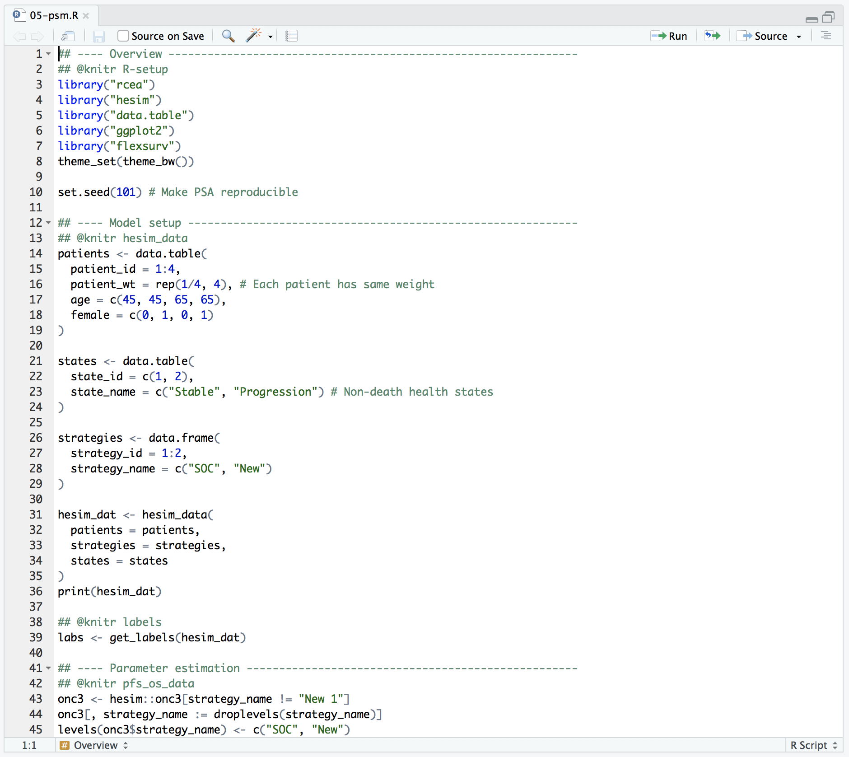
Complete R script

Slide 144
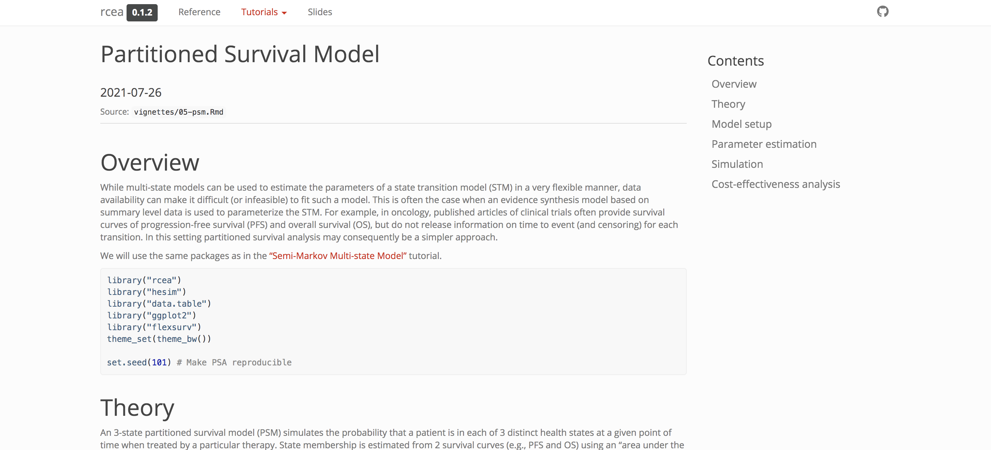
Tutorial
https://hesim-dev.github.io/rcea/articles/05-psm.html

Slide 145
Exercise 6: Partitioned survival model
Review and run the R-script “05-psm.R”

Slide 146
Summary

Slide 147
So why R for CE modeling?
One platform to do everything
parameter estimation
simulation
More complex analysis and individual patient simulation
Your problems are rarely unique
But even if they are, R facilitates development of custom models
Easier to share and review
Reproducible

Slide 148
Cost-effectiveness analysis with R
BCEA
heemod
hesim
…

Slide 149
Why hesim?
Focus on setting up and interpreting a model rather than implementation
Burdensome programming tasks have already been implemented and optimized
Flexible enough to cover many problems
May need to write custom code for very complex or unique problems (beyond scope of course)
Very fast!
IPS in hesim with 100 PSA iterations ran in .44 seconds; equivalent simulation in mstate package took 34 minutes (see here)
Cohort model in hesim with 1,000 PSA iterations ran in 1 second (IPS in 9 seconds), while equivalent cohort model in heemod took 85 seconds (see here)

Slide 150



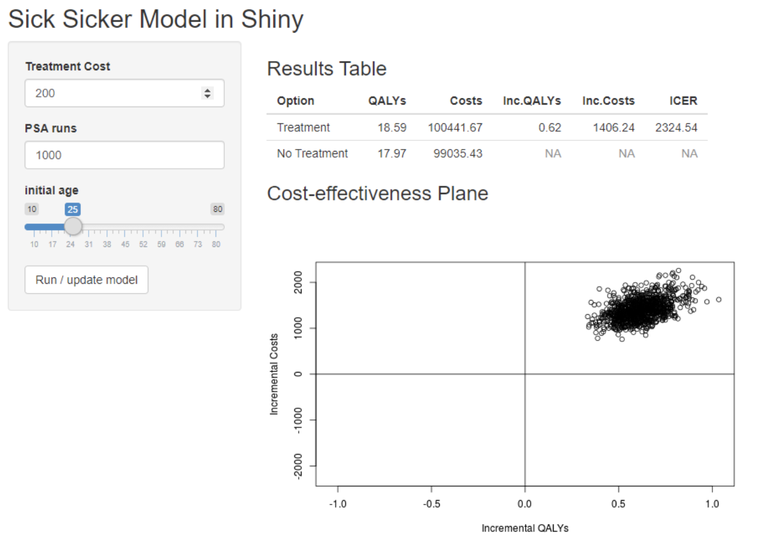
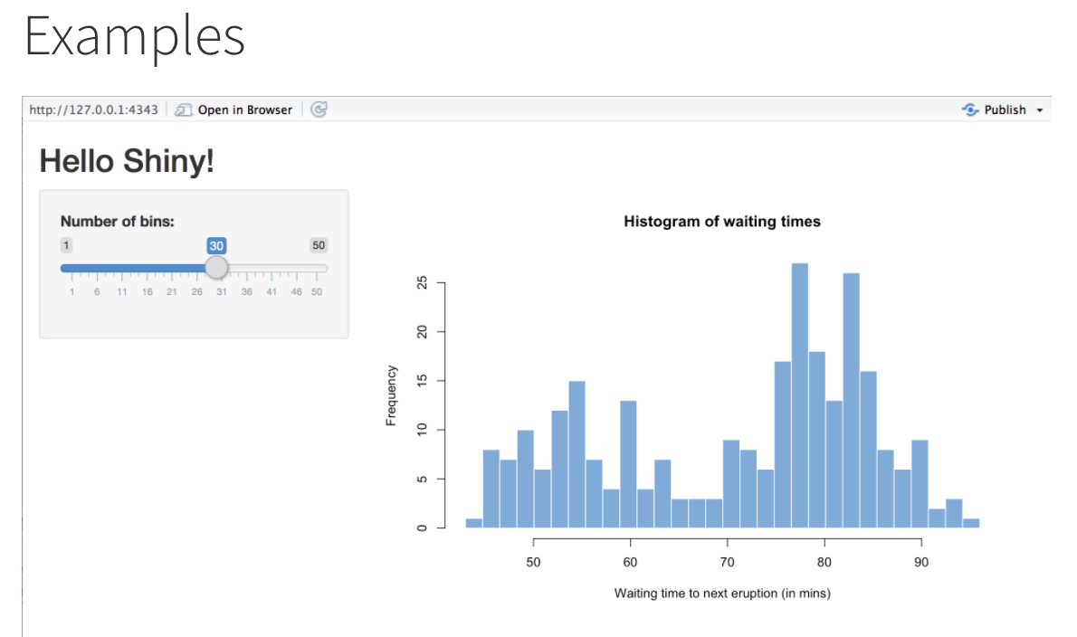
User interfaces with R Shiny
https://shiny.rstudio.com/
https://r-hta.org/tutorial/markov_models_shiny/

Slide 151


Slide 152


Slide 153
Thank you
incerti.devin@gene.com
jeroen.jansen@ucsf.edu

Slide 154
Appendix – Building a model with hesim

Slide 155
hesim

Slide 156
hesim overview
Economic model | Object | Function
Cohort discrete time state transition model (cDTSTM) | CohortDtstm | create_CohortDtstm() CohortDtstm$new()
Individual-level continuous time state transition model (iCTSTM) | IndivCtstm | IndivCtstm$new()
N-state partitioned survival model (PSM) | Psm | Psm$new()

Slide 157
hesim - Parameterization
 |  | Disease progression
Economic model |  | Statistical model | Parameter Object | Model fit Function
cDTSTM | CohortDtstm | Custom | tparams_transprobs | define_model()
 |  | Multinomial logistic regression | params_mlogit_list | multinom_list()
iCTSTM | IndivCtstm | Multi-state model (joint likelihood) | params_surv | flexsurv::flexsurvreg()
 |  | Multi-state model (transition-specific) | params_surv_list | flexsurvreg_list()
PSM | Psm | Independent survival models | params_surv_list | flexsurvreg_list()

Slide 158
hesim - Parameterization
Cost and utility
Statistical model | Parameter Object | Model fit Function
Predicted means | tparams_mean | stateval_tbl()
 | tparams_mean | define_model()
Linear model | params_lm | Stats::lm()

Slide 159
hesim - Simulation Constructing an economic model
Economic model |  | Disease model | Utility model | Cost model(s)
cDTSTM | CohortDtstm | CohortDtstmTrans create_CohortDtstmTrans() | StateVals create_StateVals() | StateVals create_StateVals()
iCTSTM | IndivCtstm | IndivCtstmTrans create_IndivCtstmTrans() | StateVals create_StateVals() | StateVals create_StateVals()
PSM | Psm | PsmCurves create_PsmCurves() | StateVals create_StateVals() | StateVals create_StateVals()

Slide 160
hesim - Simulation Simulating outcomes
Economic model |  | Disease progression | QALYs | Costs
cDTSTM | CohortDtstm | $sim_stateprobs() | $sim_qalys() | $sim_costs()
iCTSTM | IndivCtstm | $sim_disease() $sim_stateprobs() | $sim_qalys() | $sim_costs()
PSM | Psm | $sim_survival() $sim_stateprobs() | $sim_qalys() | $sim_costs()

